Slide 1
Alliance for Sustainability
Planning for Resilient Cities: Trash, Recycling and Planning
June 1, 2017

Slide 2
More information…
Let’s take a closer look at who is Ramsey County

Slide 3
Ramsey County is unique.
County Demographics
Small in size
Fully developed
Racially diverse
Economically diverse populations
Urban and sub-urban
~ 10% of states population

Slide 4
Demographics
Population: 538,000
Race
64% White (81%)
14% Asian
12% Black/African American
7% Hispanic
1% Native American
3% More than one race
Housing Units: 218,000
Owner Occupied: 59% (72%)
Median Income: $55,460 ($60,828)
Persons in poverty: 17% (12%)
Language:
126 languages in Saint Paul Public Schools
Language other than English at home: 21% (11%)
Number of businesses: 47,210

Slide 5
More information…
Who set’s trash and recycling policies in MN?

Slide 6
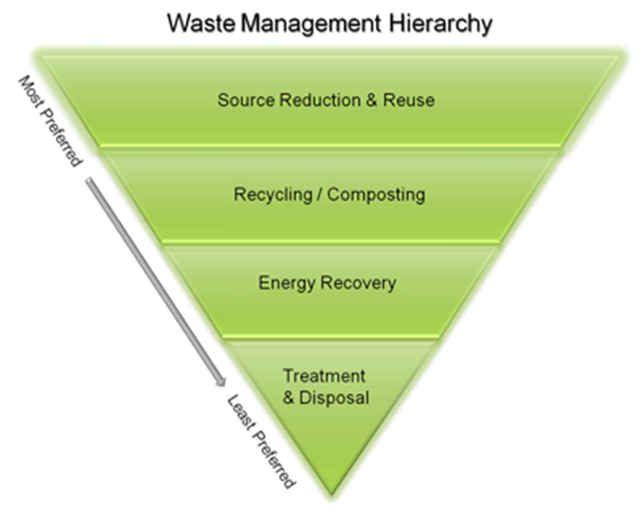
Policy Direction from the State
Stated Goals
Reducing risk to health and environment
“Abate” landfills
A hierarchy of preferred technologies
An Integrated system
Strong focus on Mixed municipal solid waste

Slide 7
Why are we here?
Ramsey County Role
Counties address all aspects – reduce, reuse, recycle, compost, waste-to-energy ultimately reducing reliance on or amount going to landfill.
Counties are responsible for:
Meeting state goals for recycling and trash management
Protection of public health and environment

Slide 8
Who we are
Solid and Hazardous waste is in the public health department
Why? Ramsey County believes in the public health approach to waste management.
Focus on prevention and relationships
Continual engagement to change behaviors
Focus on upstream behavior change

Slide 9
Cities role
What will be required in the new plan? At a minimum…
Continued provision of recycling collection services, with more specificity
Service must be available to all, including multi-family
Add organics services
Ability to measure progress
Manage day-to-day resident calls and issues

Slide 10
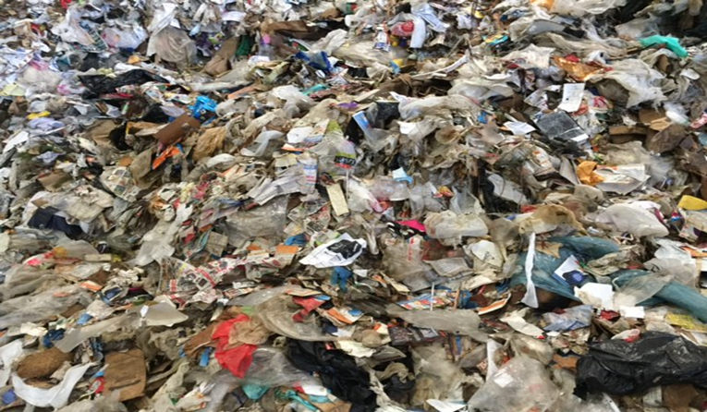
More information…
Let’s talk trash

Slide 11
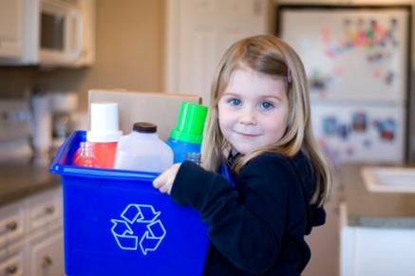
What do we mean waste?
Garbage, trash, waste, refuse, rubbish, solid waste – it’s all the same with a different name!
Garbage comes from many sources and activities, both at home and at work.
Each person produces 6 pounds of garbage and recyclables each day at home, work or school.

Slide 12
Five Key Points
Waste is complex
An effective and sound waste management system is working in our County.
Program evaluation is an important tool: the system is accountable.
Reducing risk to health and the environment is a key element of the waste management system.
The waste management system is operated by a combination of private sector and public sector participants.

Slide 13
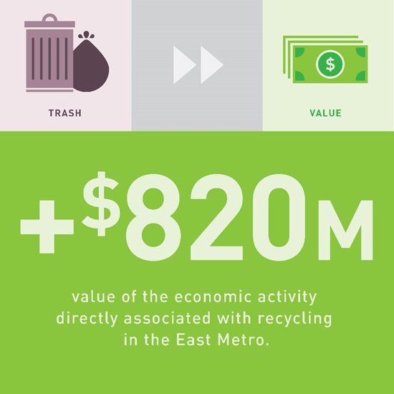
Economics of Trash
Collection costs (picking it up) are 2/3 of your trash bill – 1/3 is the cost of handling the trash
Recovering materials and energy from trash is more expensive than putting it into a landfill
Historically, subsidies are needed to provide an incentive for haulers to bring trash to the R&E Center
Recycling at home and at businesses is the best value – but not everything can or will be recycled

Slide 14
Ramsey County’s “Integrated Solid Waste System”
Reduction: primarily through education, technical assistance, economic incentives
Separate management of problem wastes
Recycling: residential & commercial
Composting: yard waste, organic waste
Resource Recovery: waste-to-energy
Land disposal: landfills

Slide 15
How are we doing?
Already a successful system
86% of waste diverted
51% of trash is recycled
38% becomes electricity
Opportunities to reduce, reuse, recycle
Hazardous wastes properly handled

Slide 16
Opportunities to capture more

Slide 17
More information…
How does trash and recycling connect to planning for resilient cities?

Slide 18
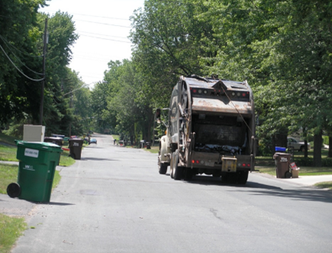
Connections to trash and recycling
Waste Prevention and Reuse Food waste and traditional goods
2. Fleet In every city, there are fleet of private hauler trucks that collect trash, recycling, organics, yard waste, oil/grease, hazardous waste, and separately collected recyclables. (Green Step 13)

Slide 19
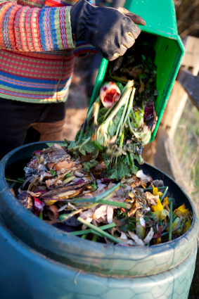
3. Organics Recycling
Recycling organics helps the environment by avoiding methane emissions that contribute to global climate change.
The products of organics recycling, renewable energy and compost, reclaims the energy and resources that went into making the food and paper and has lower Greenhouse Gas emissions than landfilling.
Returning the compost to the soil improves soil health and fertility. (Green Step 22)

Slide 20
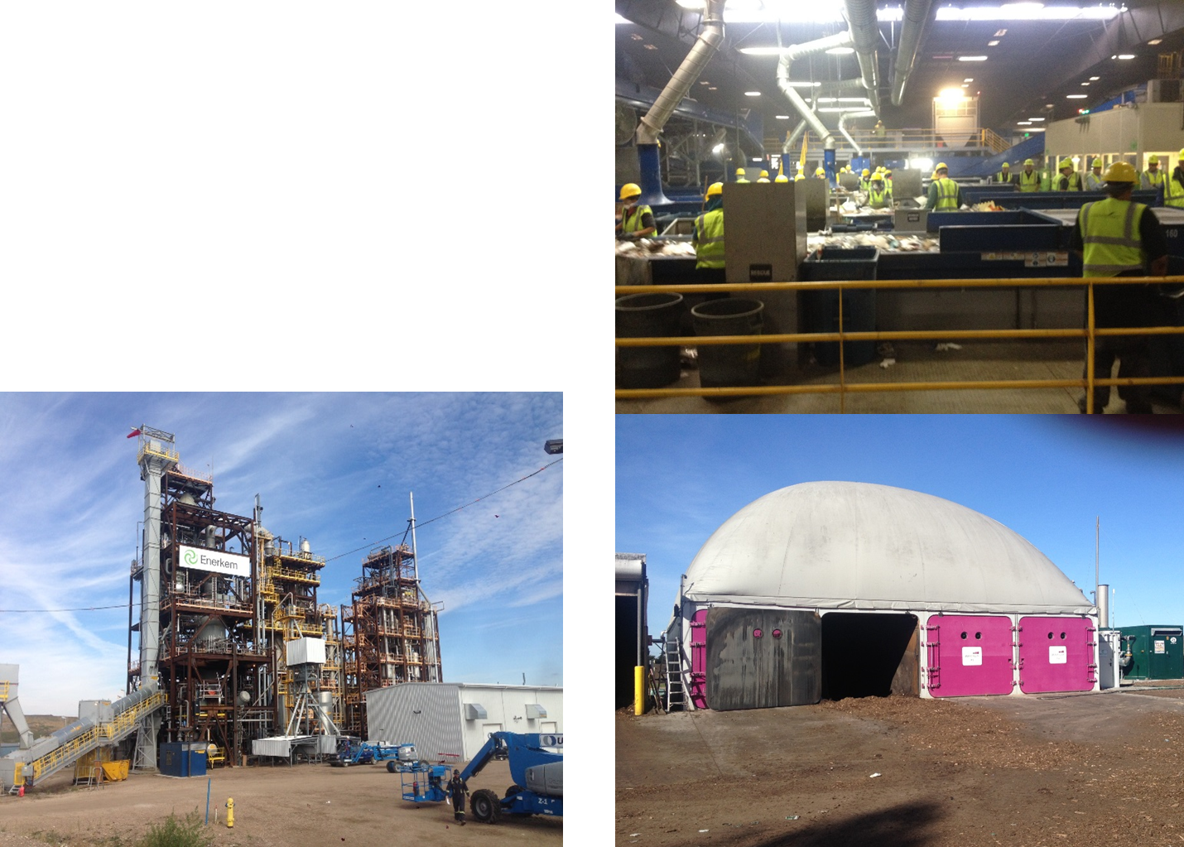
4. New Technologies New technologies are emerging that can convert waste into bio-based chemicals or fuels including Anaerobic Digestion and Gasification.

Slide 21
More information…
Ramsey County is planning for the future of trash and recycling now

Slide 22
Solid Waste Master Plan Details

Slide 23
Solid Waste Master Plan
Required by State Law
Revised every six years, with a 20-year horizon
Specific goals and mandates by MPCA
Triggered by revision of MPCA Policy Plan (Published April 7, 2017)
Policy Plan can be found at: https://www.pca.state.mn.us/waste/metropolitan-solid-waste-management-policy-plan

Slide 24
Master Plan Approval - January 2018
Timeline
We have 9 months from the issuance of the MPCA Policy Plan to prepare the Ramsey County Master Plan. Although the clock just started, we began preparation work months ago.
Notes:
Residential Recycling Survey
Business Recycling Survey
Evaluation of Waste Processing
Research papers and evaluations

Slide 25
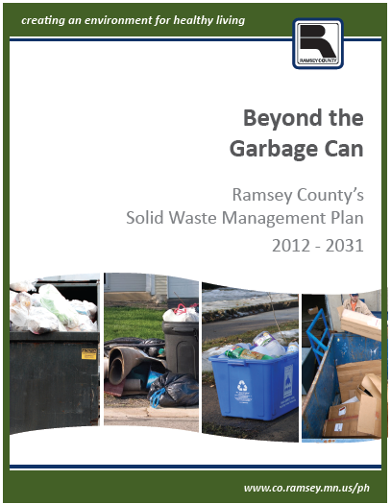
Ramsey County Master Plan
Current Plan
Regional and local component
Policies – Guide county actions
Strategies – based on meeting or exceeding state objectives, based on
Sound science,
Good judgement,
Best practices,
In partnership with others.
Notes:
Our responsibilities are outlined in a document we call the Master Plan.

Slide 26
Timeline
2017 Master Plan Timeline
Through June: Gather input from Solid Waste Advisory Committee and public.
Early draft sent to SWAC and key stakeholders for comment
July: Public draft plan available for comment.
September: Plan presented to Ramsey County Board for approval.
www.ramseyrecycles.com/masterplan

Slide 27
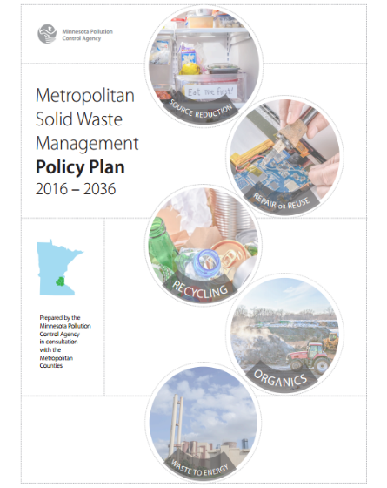
Build on successful, integrated system
Increased focus on:
Accountability
Performance driven incentives
Results
75% recycling goal by 2030
New areas of focus
Reuse
Food waste
Construction and Demolition

Slide 28
More information…
Ramsey County lens guiding our development

Slide 29
Future Thinking
Seeking to improve a robust system
Critical shift in thinking, policy and new technologies to:
Protect the environment;
Ensure success of higher recycling goals;
Keep value of resources local;
Support East Metro economic prosperity goals;
Cost effective.

Slide 30
Blending county goals with recycling goals
Ramsey County Board Goals
Strengthen individual, family and community health, safety and well-being
Cultivate economic prosperity and invest in neighborhoods with concentrated financial poverty
Enhance access to opportunity and mobility for all residents and business
Model fiscal accountability, transparency and strategic investments
​
Notes:
1) Strengthen individual, family and community health, safety and well-being through effective safety-net services, innovative programming, prevention and early intervention, and environmental stewardship.
2) Cultivate economic prosperity and invest in neighborhoods with concentrated financial poverty through proactive leadership and inclusive initiatives that engage all communities in decisions about our future.
3) Enhance access to opportunity and mobility for all residents and businesses through connections to education, employment and economic development throughout our region.
4) Model fiscal accountability, transparency and strategic investments through professional operations and financial management.

Slide 31
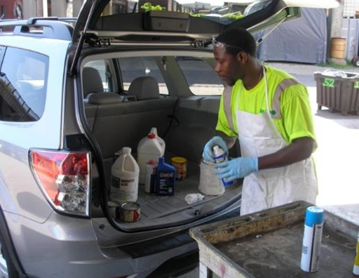
Environmental Factors
Climate Change and Mitigation
Conservation of Resources
Materials
Energy
Air Quality
Greenhouse Gas Emissions
Groundwater Protection

Slide 32
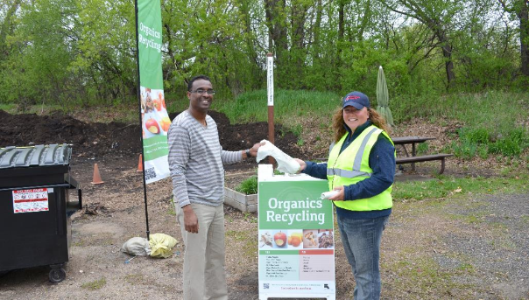
Equity Factors
Adding to Environmental Justice considerations to include:
Health Equity
Racial Equity
Economic Equity
Cultural Equity
Moving past just end disposal to opportunities, education, resources, programs, i.e.

Slide 33
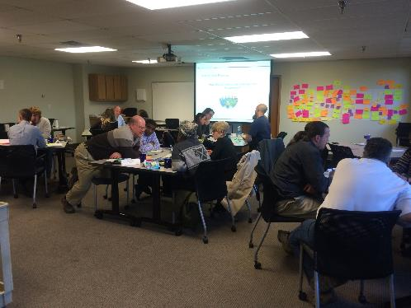
Input from our residents, business and stakeholders
Presenting at community meetings, business chamber events
Hosting an Advisory Committee
Annually surveys
Social media and online
We want to hear from you!
Survey
Dot activities

Slide 34
More information…
Kate Bartelt, Solid Waste Supervisor
651-266-1165
Kate.Bartelt@co.ramsey.mn.us
Master Plan – www.RamseyRecycles.com/MasterPlan
Waste Processing – www.MoreValueLessTrash.com
Residential Recycling – www.RamseyRecycles.com
Business Recycling – www.BizRecycling.com

Slide 35
More information…
Resource slides and information on key elements of the Ramsey County Solid Waste System

Slide 36
Garbage is classified into a few basic categories, defined in Minnesota law:
Residential – from homes
Commercial – from businesses
Industrial – from manufacturing
Construction & Demolition – from all of the above
Municipal solid waste, industrial waste, construction waste, and demolition waste are all defined in state and federal regulations.
Notes:
* Garbage or trash is often referred to as “solid waste.” Solid waste is basically non-liquid, non-hazardous garbage.

Slide 37
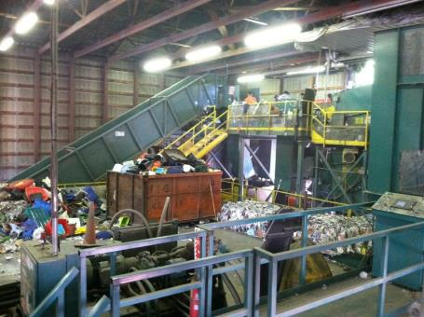
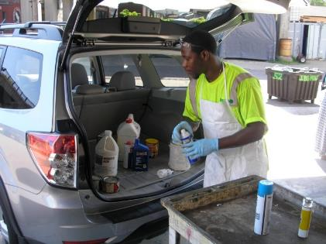
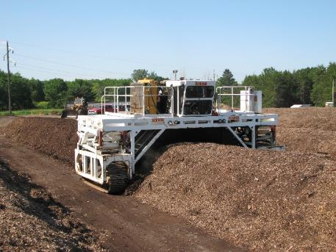
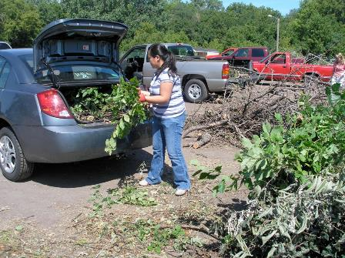
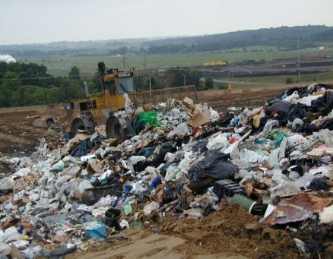
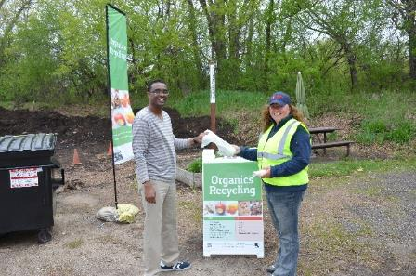
Where waste goes now
Where Waste Goes Now

Slide 38
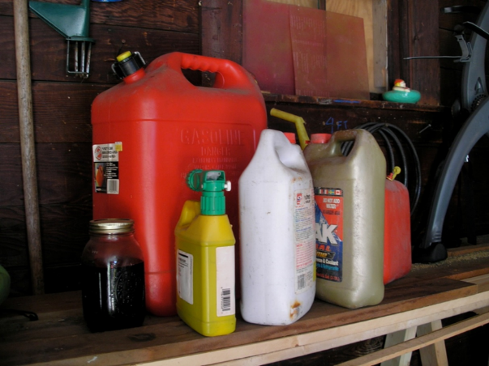
Household Hazardous Waste
Permanent program since 1991
Year-round sites with seasonal satellite sites
Operated by contractor
Separate collection opportunities exist for medicine collection with County Sherriff’s.
Notes:
Household Hazardous Waste (HHW)
HHW includes used motor oil, oil filters, pesticides, lawn chemicals, propane tanks, liquid paint, some cleaning products, old gasoline, mercury fever thermometers, fluorescent lights, pool and spa chemicals, mercury thermostats, wood preservatives, and some hobby supplies.
HHW should be taken to a County facility for proper disposal. HHW should not be mixed with garbage or poured in the street or on the soil.
Sharps (needles)
Ramsey and Washington County’s household hazardous waste facilities accept sharps, needles and lancets. Your local clinic or pharmacy may also take them back.
Medicine (pharmaceuticals)
Unwanted and unused medicines should be disposed of in the trash. Medicines should be altered to discourage consumption.
Since 1999, the majority of the latex paint brought to the sites have been recycled into paint and other useful coating products.

Slide 39
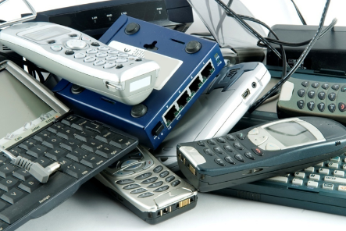
Electronics
Electronics are increasingly being recycled.
Product stewardship approach to electronics recycling: collection provided for by private sector.
Many locations for recycling exist.
Cost for recycling varies
Notes:
Electronics include computers (CPUs*), monitors (CRTs*), TVs, VCRs, DVDs, phones, laptops, automatic shut-off irons, coffee-pots, crock-pots and curlers, boom boxes, stereos, CD players, and game systems.
Electronics contain lead and other toxic materials. Recycle your electronics at a local collection event or an electronics recycling business.

Slide 40
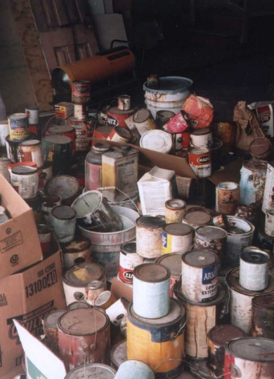
Hazardous Waste (HW) Management
Licensing
1,800 HW Generators (aka businesses and institutions producing HW)
14 HW Facilities
8 Solid Waste Facilities
Conduct over 1,500 inspections and 25 training sessions
Cradle to Grave Management
Proper management of 5.8M gallons of HW

Slide 41
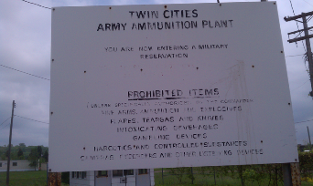
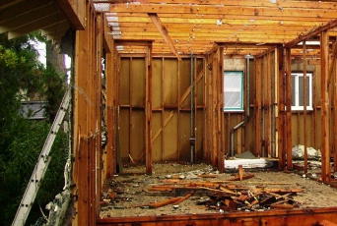
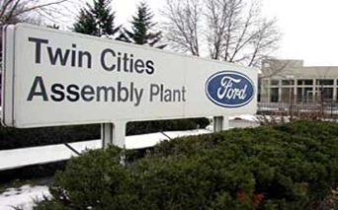
Pre-Demo Program
Promote deconstruction/building material salvage and recycling
All municipalities fully engaged
Notify Ramsey County when demolition permits are issued
Consult with Ramsey County on needed technical assistance
Reduce toxicity of demolition waste. Assure proper management of appliances, HHW/HW, electronics, asbestos.
Notes:
In 2015, 168 pre demo inspections, 70% res/30% comm/industrial,
Assuring proper management of appliances (>119,000#), HHW/hazardous waste (>107,000#), electronics (>19,170#), asbestos
Asbestos surveys performed on ALL demolitions, 147/168 asbestos found
Getting “Right Waste to the Right Place”
Reducing Toxicity of demolition waste sent for processing/landfilling
Actively promote building material salvage and recycling through technical assistance and contract language used in government procurement process
Protect human health and the environment and the long term liability of cities that contract for demolition.

Slide 42
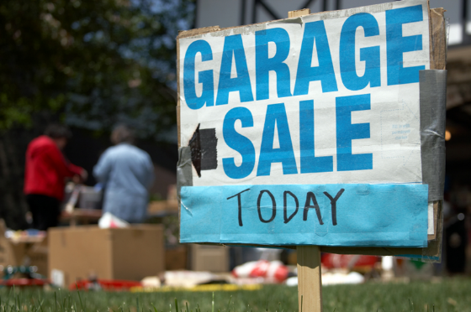
Reduction and Reuse
You can’t measure it.
Outreach efforts have focused on education and technical assistance (Fix-it Clinics).
Policy efforts have focused on product stewardship.
Strong private sector involvement (Goodwill, garage sales, consignment stores, i.e.)
Notes:
Government policy encourages product stewardship.
“A life cycle view, where all parties responsible for the design, production, sale and use of a product assume responsibility for the full environmental impacts throughout its life cycle.”

Slide 43
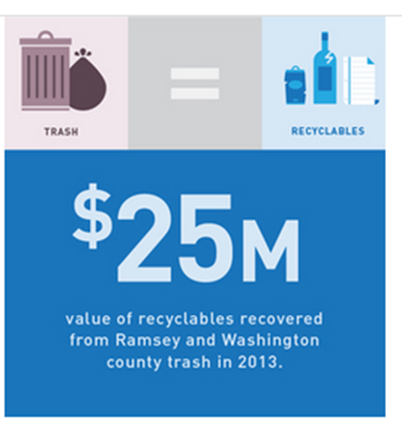
Recycling
Collected from residents and businesses. Metals extracted from trash at R&E Center.
Many types of materials recovered.
Recycling rates have not changed much in 10+ years.
Notes:
Doesn’t capture additional recycling services such as confidential records destruction, transfer stations pulling items for recycling, or folks that self haul metals to recycling end markets.

Slide 44
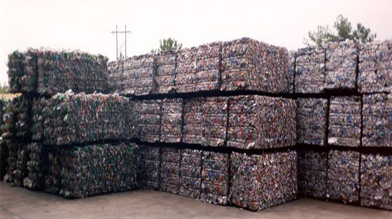
Recycling services
For Residents: Curbside collection services arranged by all municipalities except Mounds View.
For Businesses: Businesses are responsible for arranging recycling services and can be served by one or more vendor.
Recyclables collected are separated at local recycling facilities.
Notes:
Recycling is a global commodity

Slide 45
Recycling Important Points
Recycling is sensitive to the price of garbage disposal: the cheaper it is to dispose of garage, the less recycling occurs.
Materials to be recycled are changing (i.e. light weighting of plastics, reduced newspapers).
Most recycling tonnages comes from commercial sources.
Most residents and businesses self identify as already recycling all that they can.

Slide 46
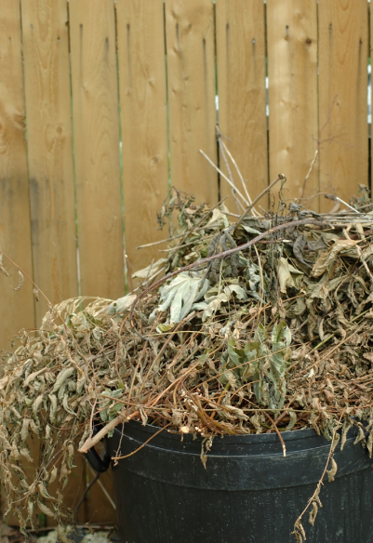
Yard Waste
Banned from trash
Includes leaves/grass and tree waste
Ramsey County has 7 yard waste sites
Open since Mid-1980’s
Communities selected location for sites
Open year round and free for residents
Notes:
Yard waste includes leaves, grass and other soft-bodied garden waste.

Slide 47
Organics options for residents
Reduce food waste
Home (Backyard) composting
Drop-off compost at Ramsey County Yard Waste sites or other compost drop-off locations
Currently there are no municipalities offering curbside organics collection although several of cities have included the option in its recycling contracts.
Notes:
Compostables are vegetable peelings, fruit scraps, tea leaves, coffee grounds, small bits of paper towel and napkin and other items that break down naturally.

Slide 48
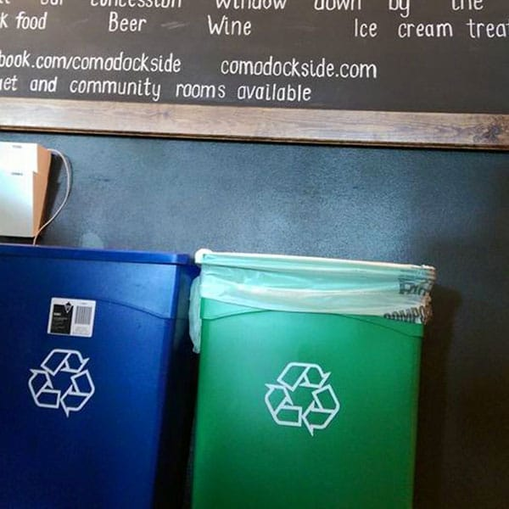
Organics options for businesses
Reduce food waste
Contract for service
Food-to-people donations
Food-to-hogs
Composting
Separately collected in cart or in a durable compostable bag.
Service reliability has been a problem.
Cost of compostable bags and products, if needed, can be a barrier.

Slide 49
Items Banned for MSW or Landfills
Cathode Ray Tubes (115A.9565)
Major Appliances (115A.9561)
Fluorescent Lamps/bulbs (115A.932)
Yard Waste, brush (115A.931)
Certain dry cell batteries (115A.9155)
Rechargeable batteries (115A.9157)
Lead acid batteries (115A.915)
Mercury containing devices (115A.9132)
Telephone directories (115a.915)
Motor vehicle fluids and filters (115A.916)

Slide 50
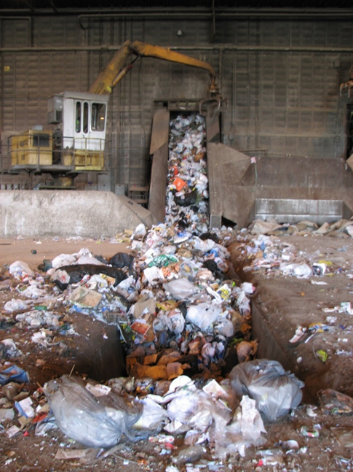
Trash not recycled or separately managed
Managing Trash
~80,000 tons to landfill
~320,000 tons to R&E Center
Designation to begin on Jan 1, 2018 will require all trash to be delivered to the R&E Center.

Slide 51
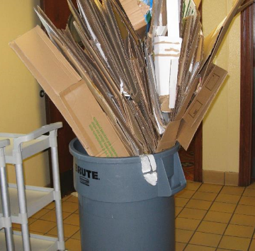
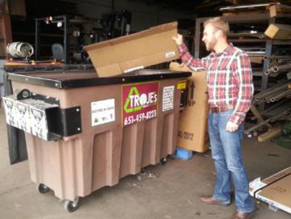
Trash Collection Services
Provided by private haulers
Organized vs. Open Collection (Residents)
6 municipalities have organized residential garbage collection
100+ licensed garbage haulers in Ramsey County
Very competitive
Rates are set by contract cities
Otherwise rates are not regulated

Slide 52
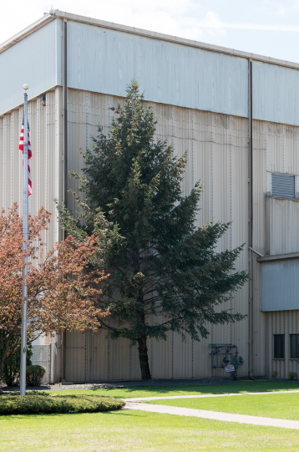
Resource Recovery
Recycling & Energy Center is owned by the Ramsey/Washington Recycling & Energy Board.
Shreds trash to produce a value added fuel which is shipped to two power plans to generate electricity.
R&E Center is located in Newport, MN
Metals are extracted from the trash for recycling
Notes:
Resource recovery reduces waste volume, recovers materials and energy
Historic Program Results
Eliminated the need for a 100 acre landfill, 40 feet deep
Recycle 329,000 tons of metal, resulting in an energy savings equal to 1.4 million barrels of oil, and 664,000 metric tons of CO2
Saved over 480,000 metric tons of CO2 equivalent, when compared to Xcel’s portfolio of energy production; equal to 1.14 billion passenger car mile

Slide 53
Landfill Operations
Landfills are difficult and expensive to site
Landfills are relatively cheaper to operate, in the short term
Landfill emissions affect air and water

Slide 54
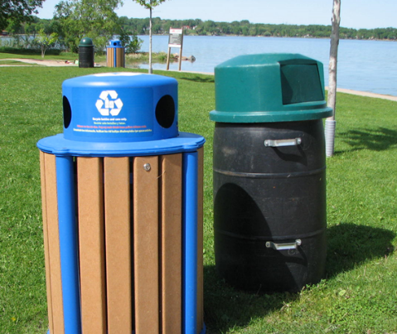
Summary
There is a lot of waste out there, and it needs to be managed.
Proper solid waste management is necessary for the protection of public health and the environment.
The State has, to date, emphasized protection in its laws.
The region has created a successful integrated waste management system.

Slide 55
Contact:
Kate

