Slide 1
Enhancing the Urban Canopy Through Ordinance and Collaboration
Michael Orange, orange_michael@msn.com, 952-905-1448 Workshop for Dakota County Communities, Planning for Resilient Cities, 6/27/17

Slide 2
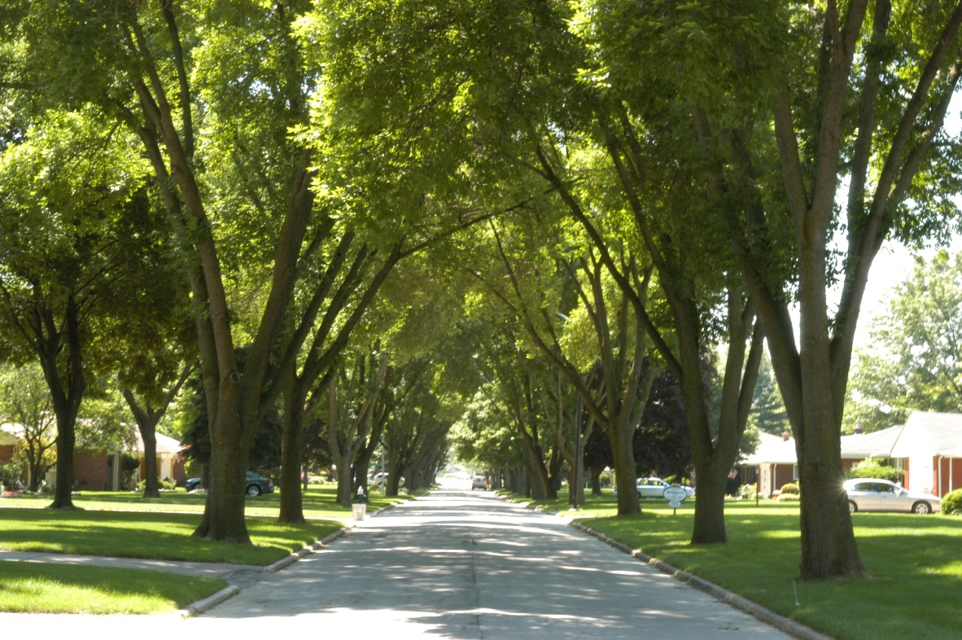
Everybody loves trees
Photos courtesy Dr. Dan Herms

Slide 3
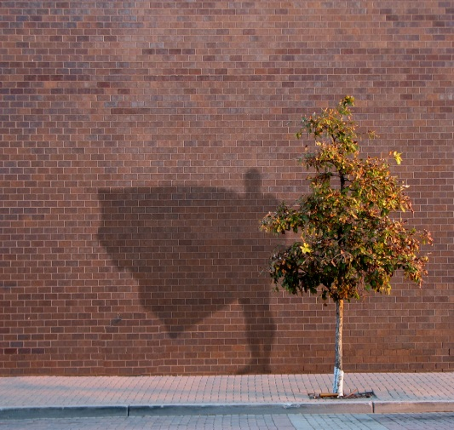
Infrastructure Superhero
Reduce stormwater runoff
Save energy
Store carbon
Improve air quality
Improve human health
Increase property values
Reduce crime
Reduce noise
Photo courtesy of Rainbow TreeCare

Slide 4
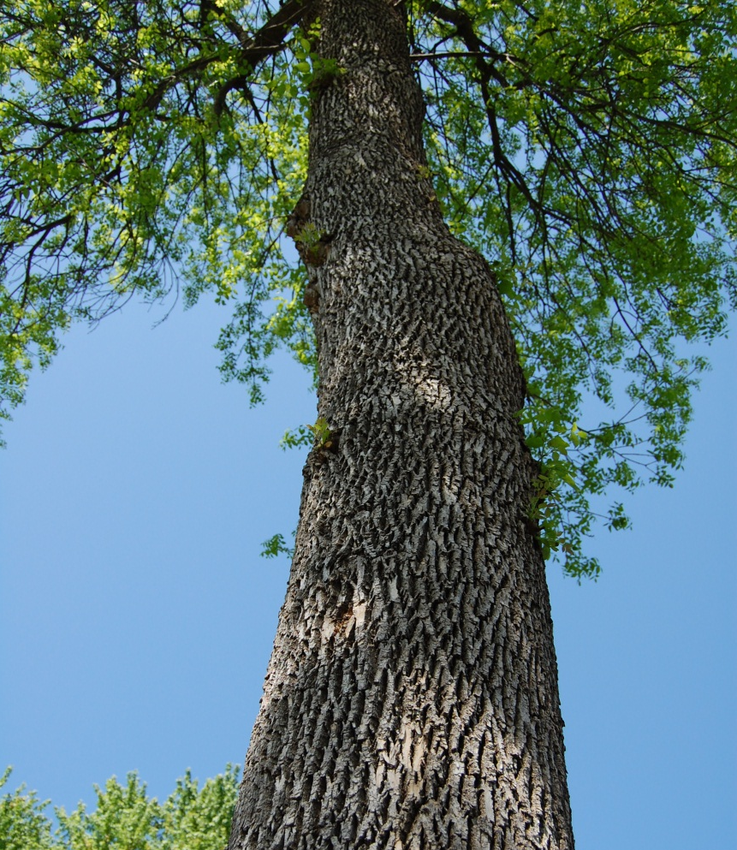
Tree benefits:
The average urban ash tree provides benefits of $190 per year.
Tree benefits outweigh tree costs by 3 to 1.
A new tree is not equivalent to an old tree.
From the National Tree Benefits Calculator www.treebenefits.com and Rainbow TreeCare

Slide 5
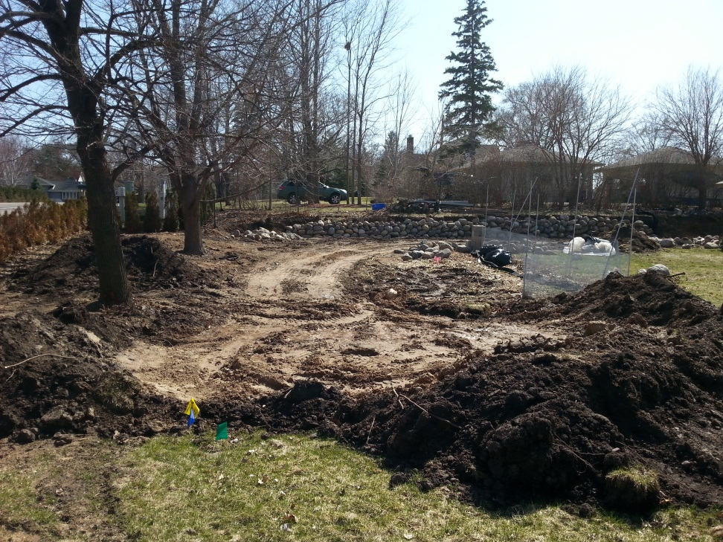
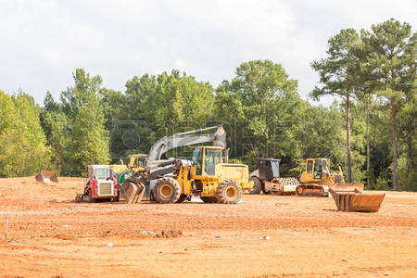
Don’t treat soil like it was dirt
Compaction by equipment and material storage and changes to drainage have long-term impacts on soils and trees both on site and off site.
Photo courtesy of Rainbow TreeCare

Slide 6
Don’t treat soil like it was dirt
“There are more life forms in a handful of soil than people on the planet.
A mere teaspoon contains many miles of fungal filaments. All of these work the soil, transform it, and make it so valuable for the trees.”
Wohlleben, Peter, The Hidden Life of Trees, p. 86.

Slide 8
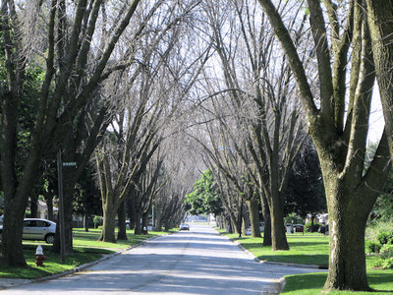
Emerald Ash Borer (EAB) Infestation
Most damaging forest insect ever to invade the U.S.
A predictable natural disaster
June 2006
June 2009
Toledo, OH. EAB discovered in 2003
Photos courtesy Dr. Dan Herms

Slide 9
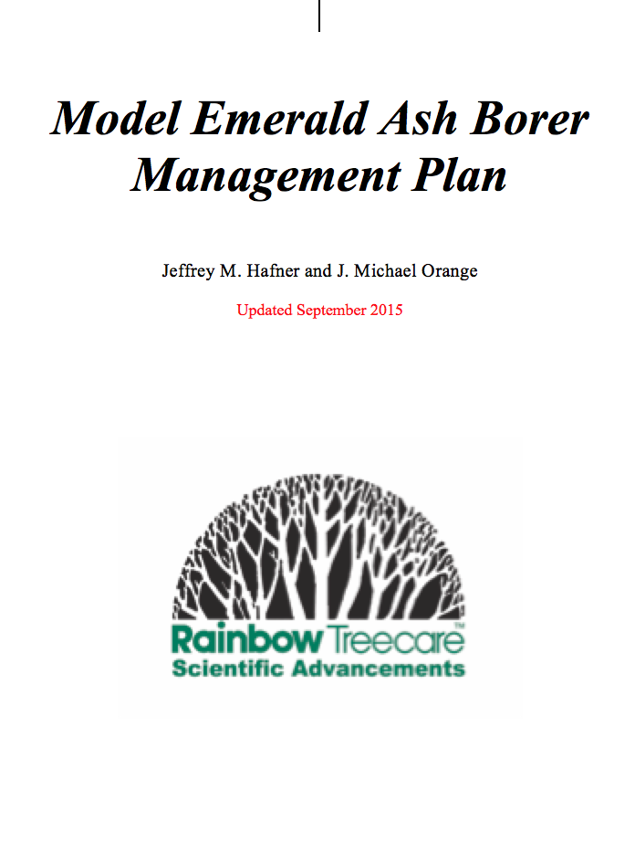
EAB Infestation: A predictable natural disaster
Ash constitute about 20% of the public trees in MN cities.
Average EAB management cost for a city in the region: $800,000 to $1.5 million.
Minimize the environmental and economic damage via science-based management:
Save the best and replace the rest.
Cost of removing and replacing 1 average-sized tree could preserve 2 healthy trees that will provide 4 times the tree benefits.
EAB management plan.

Slide 10
EAB Infestation: A predictable natural disaster
Ash constitute about 20% of the public trees in MN cities.
Average EAB management cost for a city in the region: $800,000 to $1.5 million.
Minimize the environmental and economic damage via science-based management:
Save the best and replace the rest.
Cost of removing and replacing 1 average-sized tree could preserve 2 healthy trees that will provide 4 times the tree benefits.
EAB management plan.
Intercity or statewide collaboration: More cost-effective and better for the environment than a city-by-city approach.

Slide 11
Conclusion:
A fuller appreciation of the importance of our green infrastructure can lead to urban forests that deliver the substantial benefits that were the long-range hope of those who planted the saplings.

Slide 12
Enhancing the Urban Canopy Through Ordinance and Collaboration
Michael Orange, orange_michael@msn.com, 952-905-1448 Workshop for Dakota County Communities, Planning for Resilient Cities, 6/27/17

