Slide 1

Thriving resilient cities
Edith Makra, Metropolitan Mayors caucus
June 20, 2019

Slide 2
Overview
Building the GRC
The GRC in 3 parts
  Compact
  Framework
  Collaborative programs to advance GRC goals
GRC communities & GRC leaders

Slide 3
GRC Goal
To align environmental issues, resources, and actions at the local, regional and national levels to guide municipalities to achieve greater environmental sustainability.
Notes:
Ostenburg
Ok to read the goal –
Bottom line.
We have to work together and strategically.
Not enough resources to get much done without aligning efforts

Slide 4
Building the GRC

Slide 5
Building the GRC2
1. What is already underway in the region?
2. What existing programs will be helpful?
TO ANSWER THOSE QUESTIONS -
Inventoried environmental achievements for 290 municipalities

Slide 6
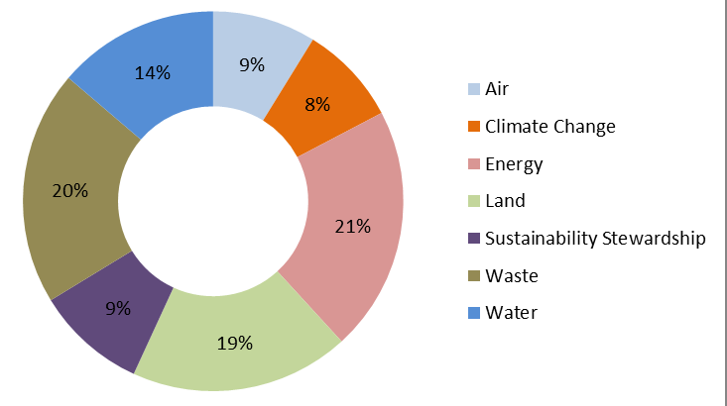
What sustainable actions are munis already doing?
Notes:
Edith
Normalized – land achievements nearly 30%
Normalized for dominance of land and scarcity of waste achievements

Slide 7
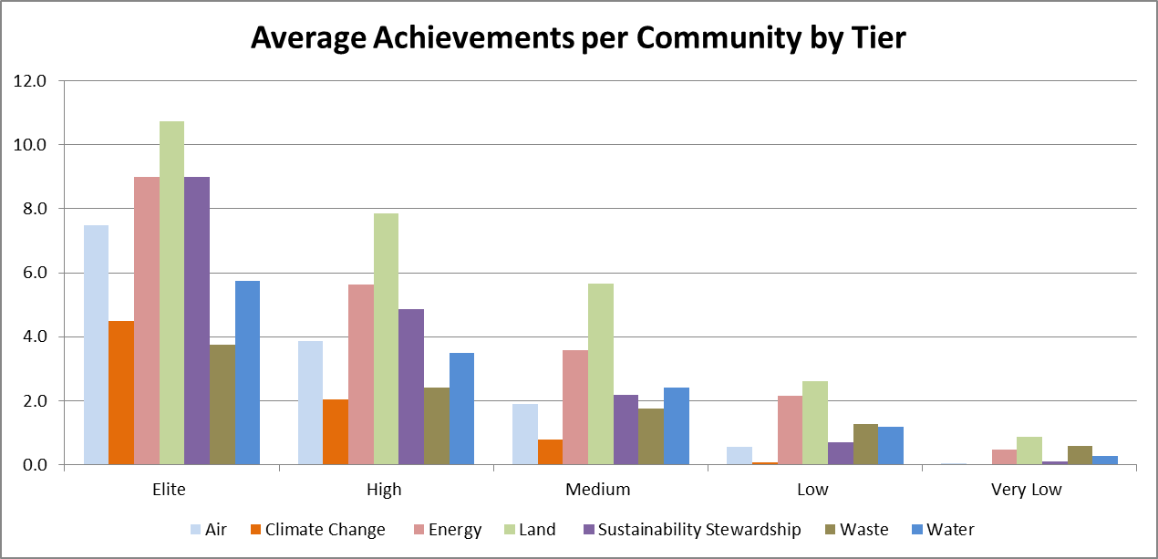
Which communities are sustainable?
9%
71%
1%

Slide 8
Building the GRC2
What is already planned?
What are common priorities?
TO ANSWER THOSE QUESTIONS -
Analyzed existing sustainability plans
  30 local plans
  9 regional/national plans
  1149 specific sustainability goals

Slide 9
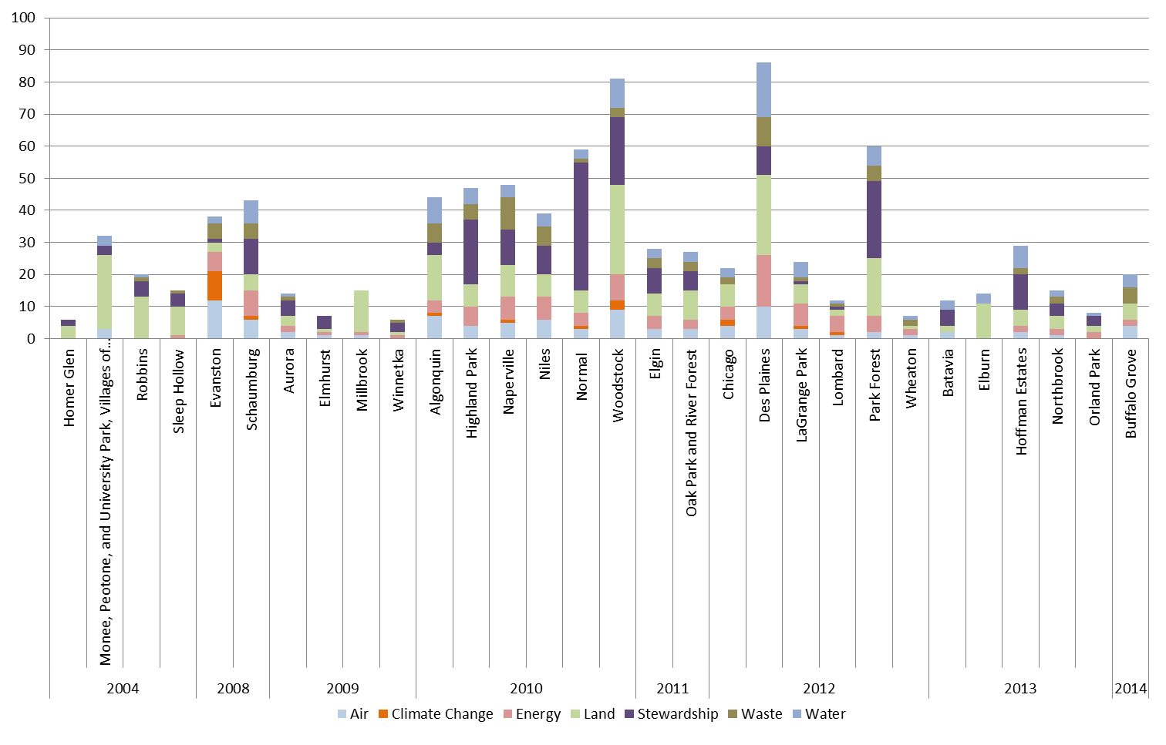
ALL LOCAL SUSTAINABILITY PLANS IN GRC
*based on GRC+2 categories

Slide 10
Greenest Region Compact
consensus sustainability for communities and the region
In three parts

Slide 11
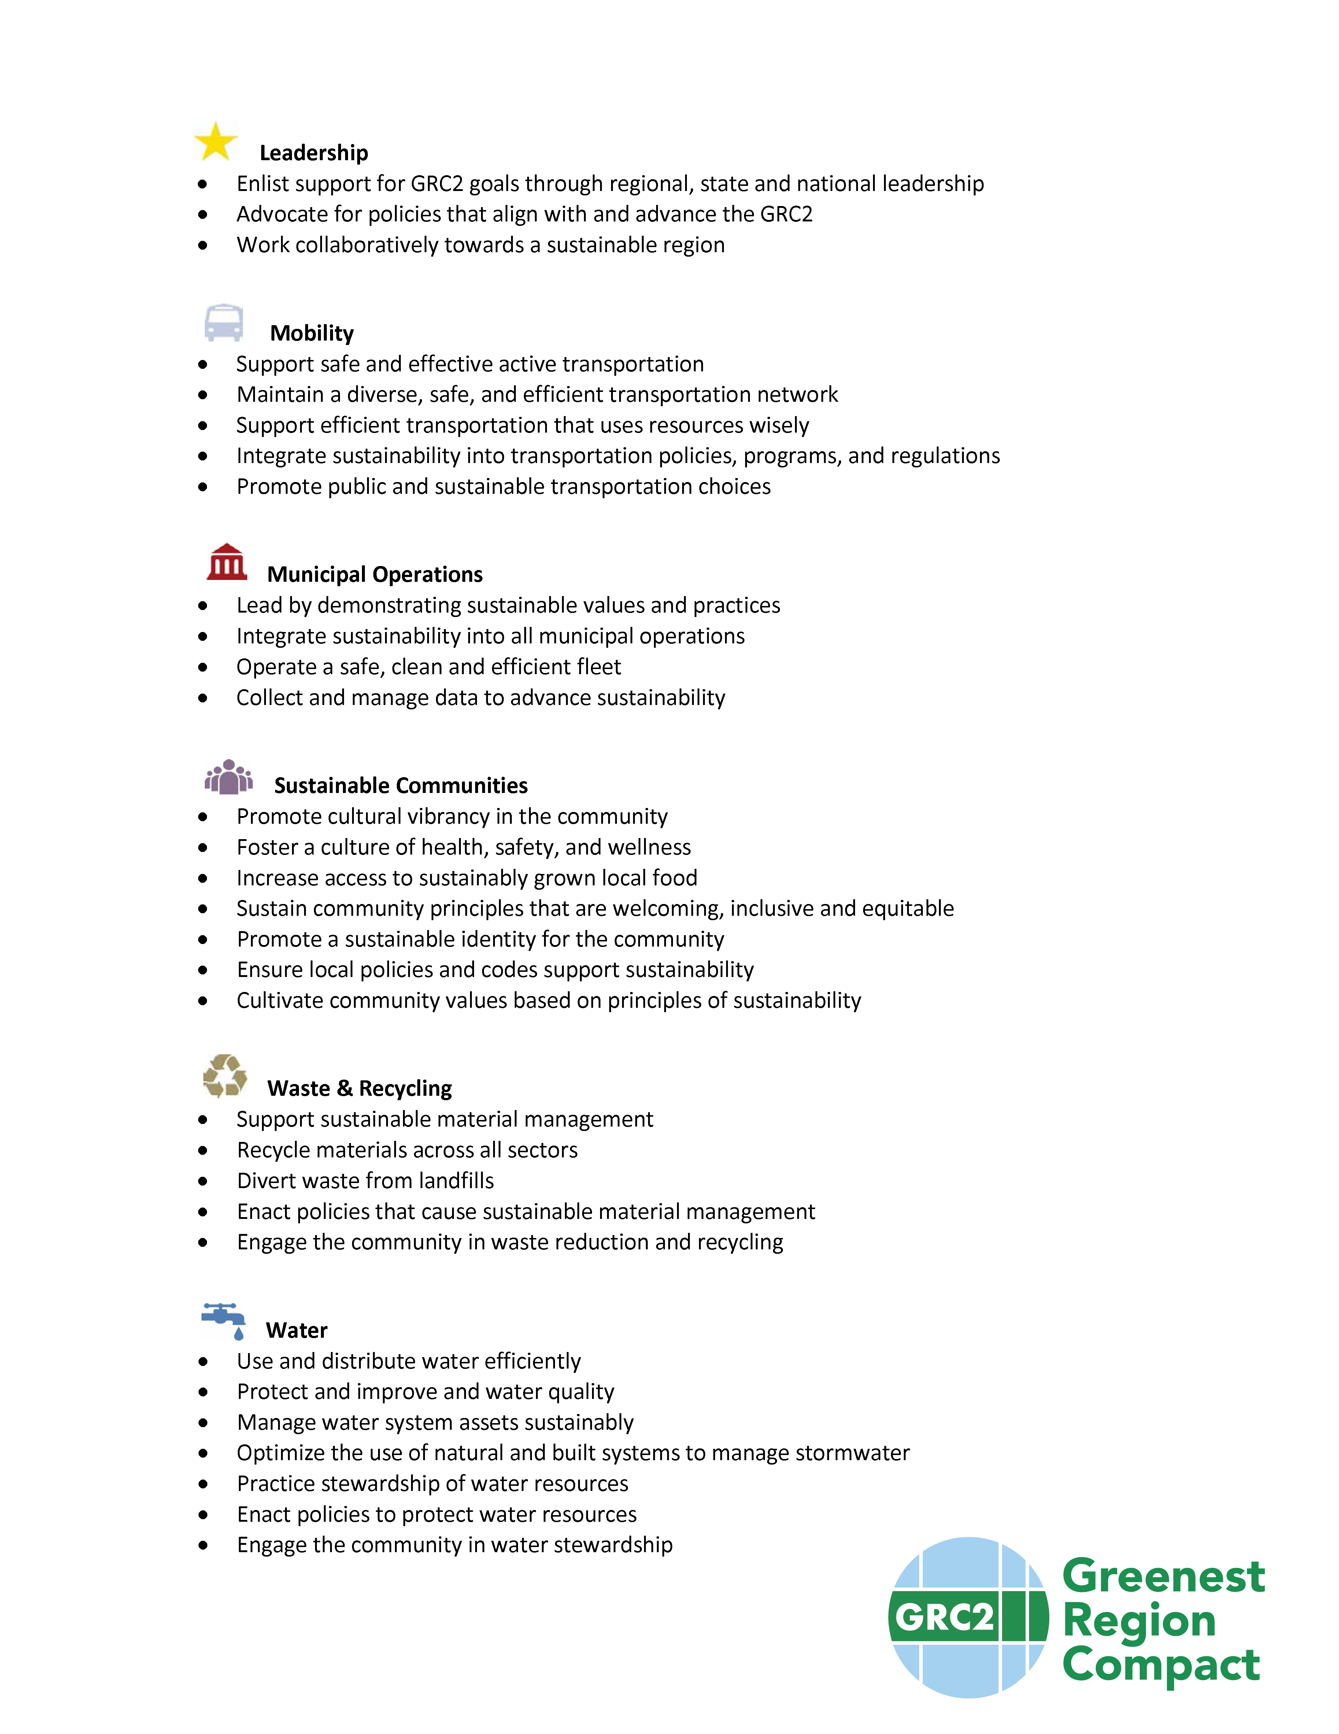
Part 1
The Compact – Just Goals

Slide 12
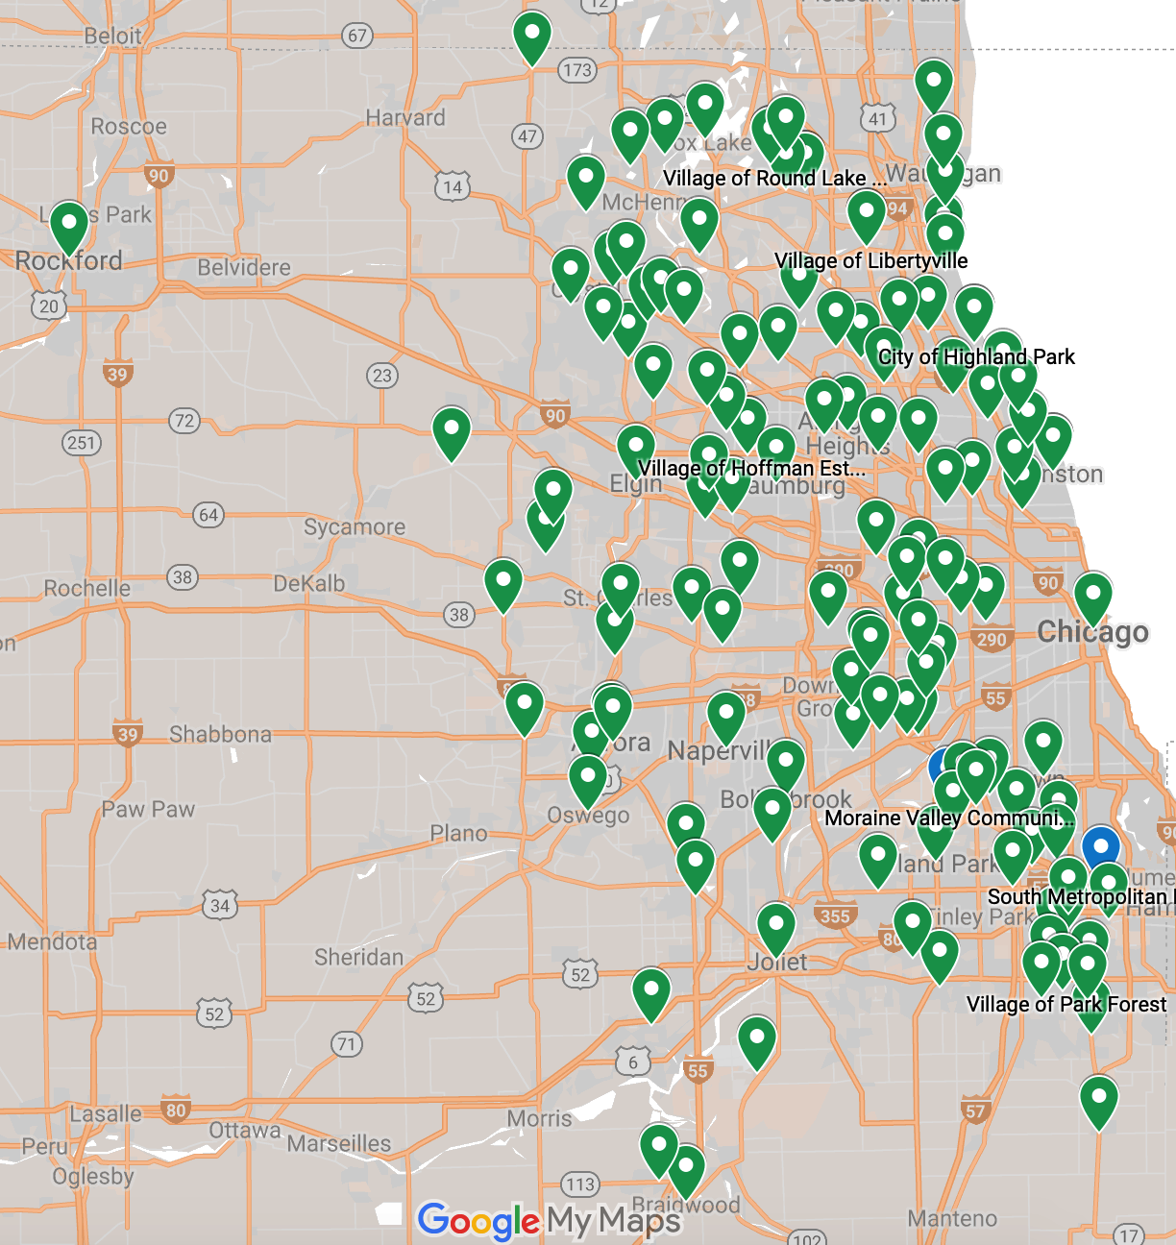
GRC Adopters by Resolution
119 municipalities
2 counties
10 COGS
Barrington Area Council of Governments
Lake County Municipal League
McHenry County Council of Governments
Metro West Council of Governments
Northwest Municipal Conference
South Suburban Mayors & Managers
Southwest Conference of Mayors
West Central Municipal Conference
Will County Government League
DuPage Mayors and Managers Conference

Slide 13
Part 2 - The GRC Framework
Compilation of all Common Objectives, Strategies
  Aligns with regional, national, global objectives
  Links to resources & existing programs
Framework for community sustainability plan
No reporting or commitment required

Slide 14

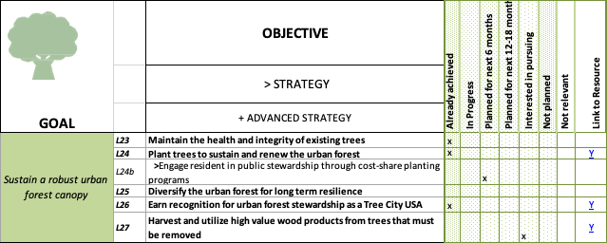
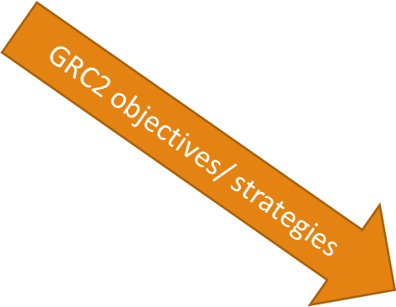


Slide 15
Part 3 –GRC Collaborative Programs
Collaborative programs to realize GRC goals regionally
Leverage municipal consensus
Engage mayors and elected officials
Grants
Collaboration to address specific GRC goals

Slide 16



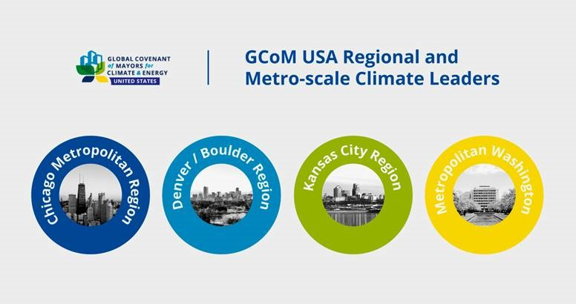
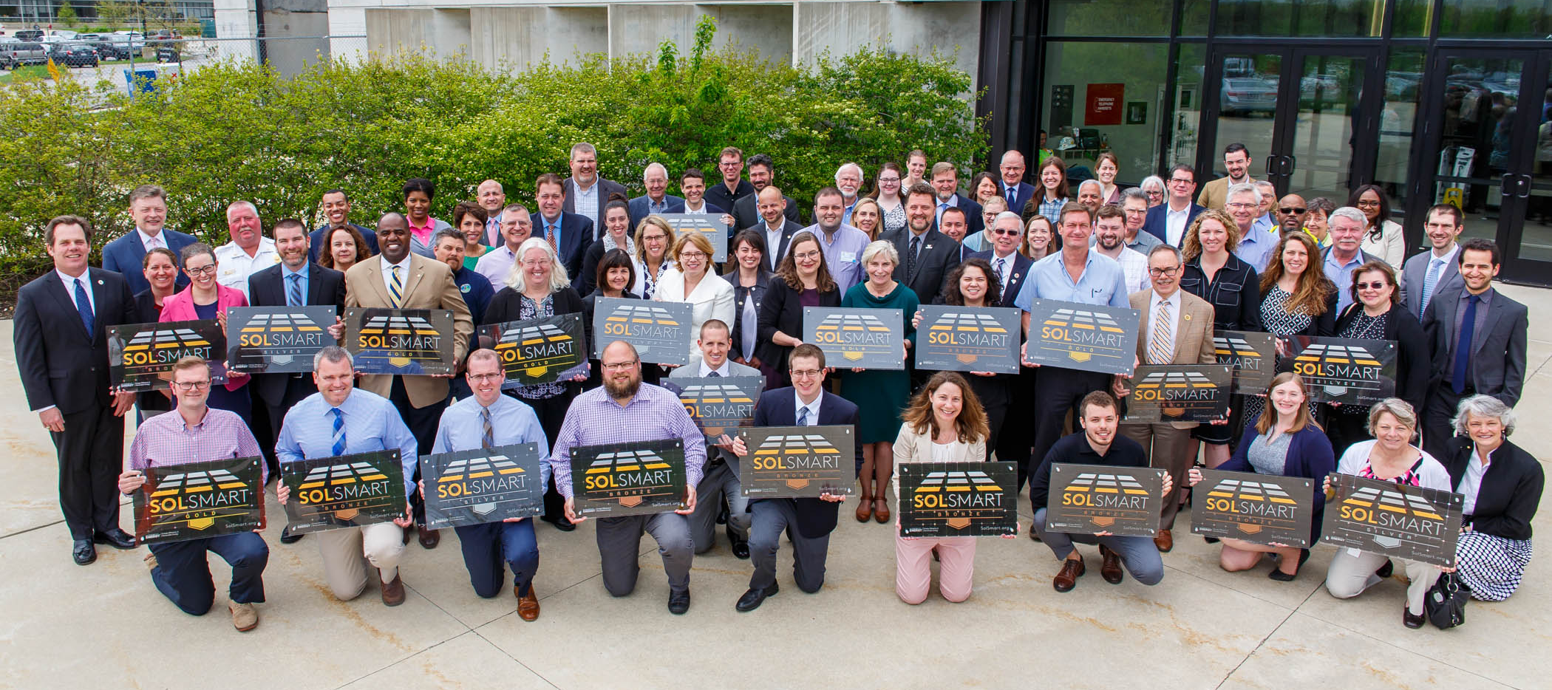
Addressing GRC Goals together
Advance renewable energy
Led 35 local gov’s to earn SolSmart by streamlining solar codes & policies making IL #1
Measure and monitor GHG emissions
Selected for regional planning pilot

Slide 17
Edith Makra
Director of Environmental Initiatives
Metropolitan Mayors Caucus
312-201-4506
emakra@mayorscaucus.org
http://mayorscaucus.org/initiatives/environment/rec/

