Slide 1
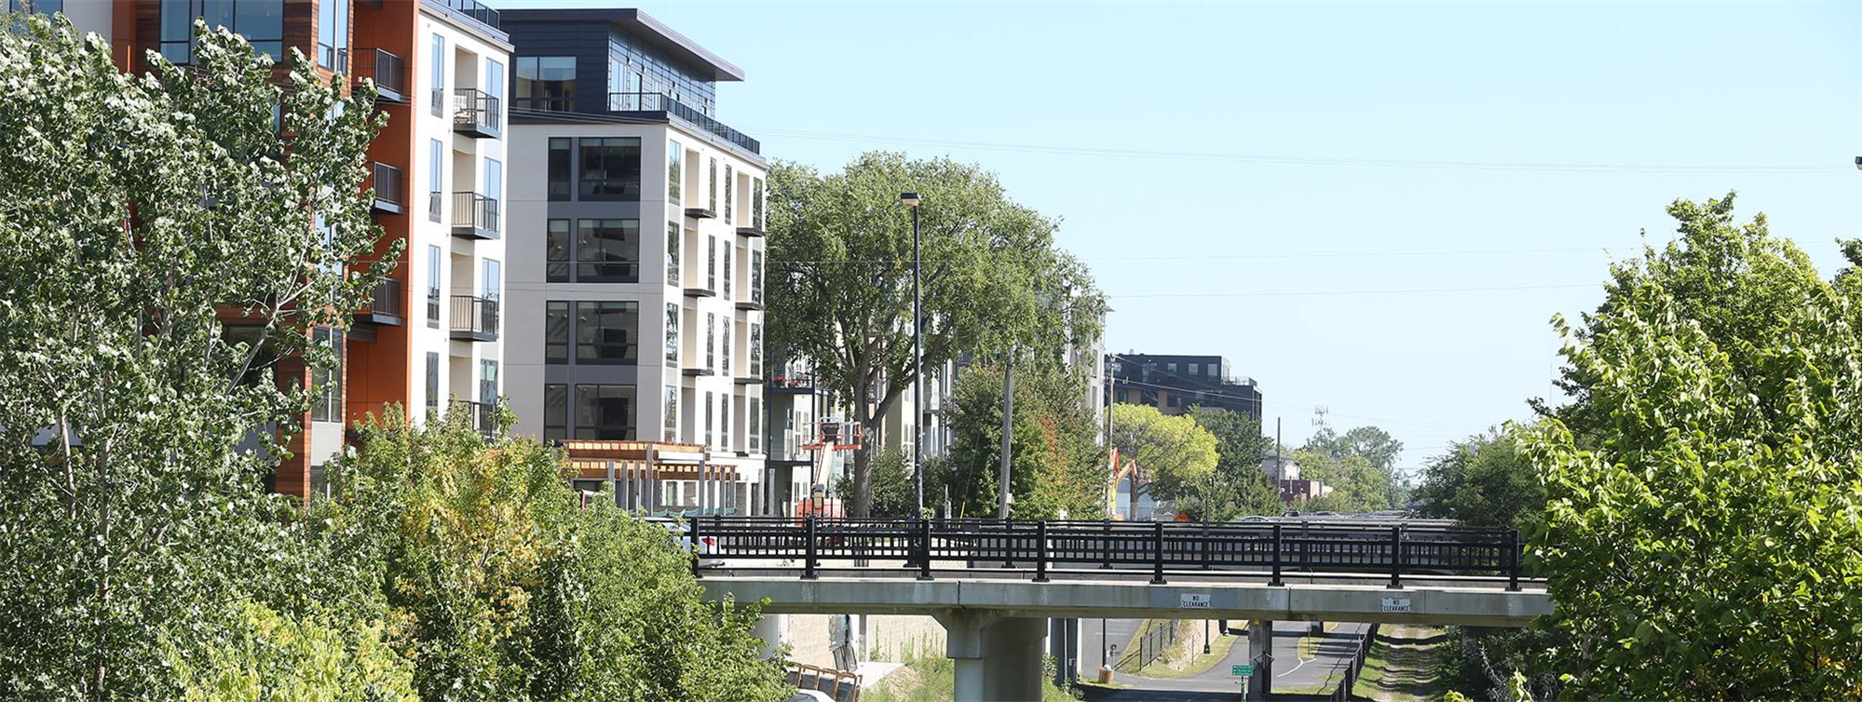
Comprehensive Planning for Health:
Tools and examples
Alliance for Sustainability
November 09, 2017
Denise Engen
Hennepin County Public Works, Healthy Community Planning
Notes:
DENISE
Hi, my name is Denise Engen. I work for Hennepin County, in the County's large Public Works Department – on the Healthy Community Planning team
(which is within the Community and Economic Development section).
Our teams work is interdisciplinary, and connects health and the built environment with community – specifically connecting community health to community planning and development. We…
Provide technical support and funding for partner cities and agencies,
Incorporate active living into Hennepin County policy and processes, and
Practice and promote inclusive community engagement around transportation projects
Leverage Public Works resources for public health priorities and leverage PH resources for PW priorities.
Examples:
HIA, SAP, work with cities to engage residents around active living, bike/ped plans in 8 cities + Bottineau corridor, develop transportation policies, host demonstration projects on proposed bike/ped projects, and provide bikes and bike education to low income residents.)

Slide 2
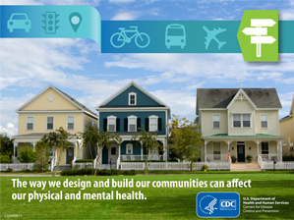
Communities & health are connected
The physical and mental health of individuals is strongly influenced by their environments
    Similarly, the health and vitality of a community depends on its people
Notes:
I am here today to talk to you about the intersection of city planning and community health – and why health is important to the practice of city planning today. Our health and individual prosperity are strongly connected to the health, livability and prosperity – and sustainability – of our communities.

Slide 3
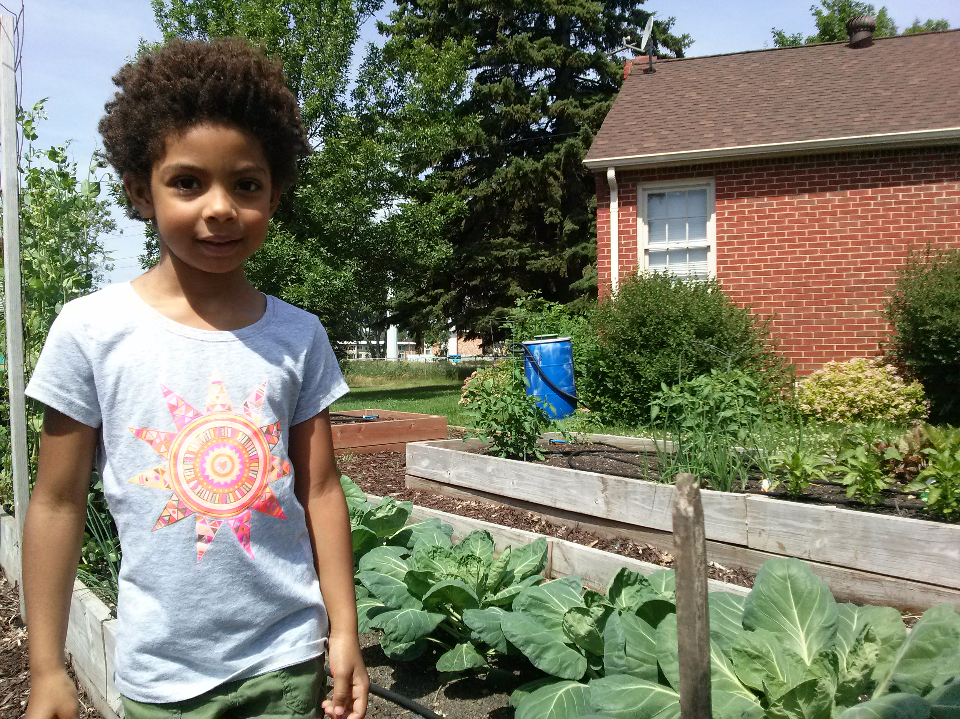
Health is more than biology & medical care
The World Health Organization (WHO) defined health in its broader sense in its 1948 constitution as
    "a state of complete physical, mental, and social well-being and not merely the absence of disease or infirmity."

Slide 4
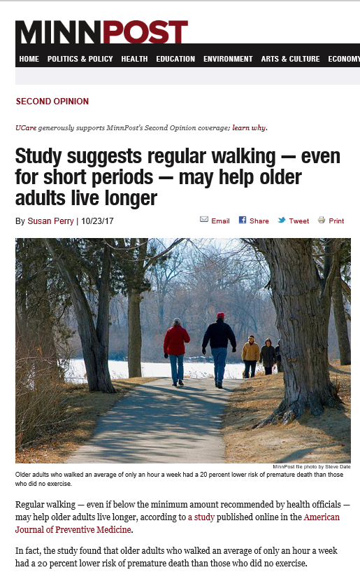
Healthy communities make healthy people
Many of the problems and solutions to improving our health are affected by how we plan and design our built environments
Notes:
Many of the problems and solutions to improving our health are affected specifically by the built environment. If you live in an environment where healthy behaviors are not easy to engage in, you end up with behaviors that are not healthy. A lot of these behaviors are related to the built environment and the regulatory environment. (example presence of sidewalks, grocery stores, access to transportation).
In addition to city public health ordinances, there are many different city policies regulating community and economic development that sculpt the built environment. These influence or direct where land uses can be located, what uses can be next each other, what uses are allowed in different areas, when they can operate - and sometimes even what they can sell. Examples are zoning ordinances, complete streets ordinances, smoking ordinances, code enforcement, design regulations, park dedication ordinances, floodplain regulations… and more.

Slide 5
Determinants of health
Around
80% of our health
has a social or environmental component
Notes:
This chart illustrates the conditions that contribute to our health. As you see, approximately 80% of our health as a social or environmental component. In this presentation we will be focusing on three of the areas you see in this circle: Social and economic factors (40%), the physical environment (10%) and health behaviors – how we react to our social and physical environment – (30%)

Slide 6
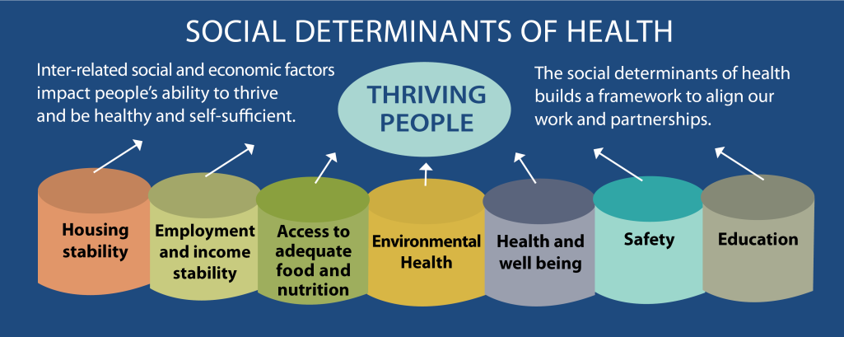
Social determinants of health
Conditions in the places where people live, learn, work and play affect a wide range of health risks and health outcomes. These conditions are known as social determinants of health (SDOH)
Notes:
The are conditions in the social environment, the physical environment (built and natural) and economic environment

Slide 7
Social determinants of health
SDOH are conditions that interact to increase or decrease risks and outcomes for major diseases
    Such as heart disease, stroke, diabetes and some forms of cancer.
SDOH also explain, in part, why some Hennepin County residents are healthier than others, and why Hennepin County residents overall are not as healthy as they could be.
Notes:
SDOH are conditions that interact to increase or decrease risks and outcomes for major diseases such as heart disease, stroke, diabetes and some forms of cancer.
Social determinants of health affect a person’s stress levels, access to healthy food, safe places to be physically active, exposure to environmental hazards and availability of early learning opportunities.

Slide 8
Planning for a healthy community

Slide 9
Planning and health
Many of these conditions are place-based, that is,
they are affected by the built environment.
Since the practice of community planning
plays a significant role in shaping the built
environment, local planning can have
real and significant impacts on increasing
community health.
Notes:
If you live in an environment where healthy behaviors are not easy to engage in, you end up with behaviors that are not healthy. A lot of these behaviors are related to the built and the regulatory environments.

Slide 10
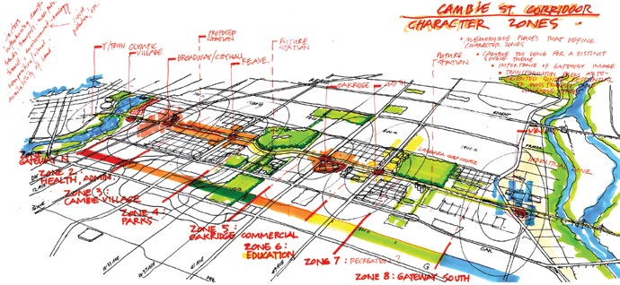
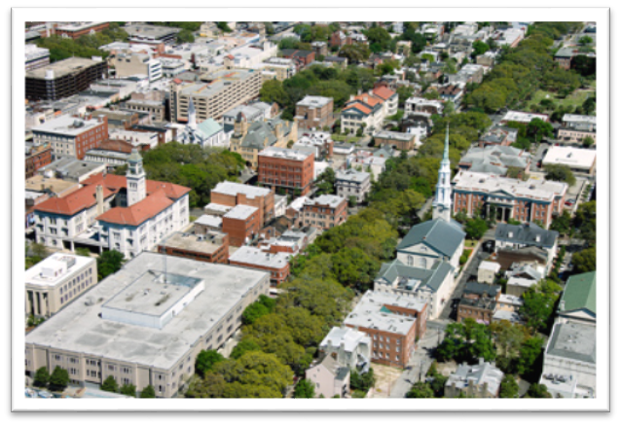
Planning and health
Since the practice of community planning plays a significant role in shaping the built environment
Local planning can have
real and significant impacts on increasing community health
Planning and designing communities with health in mind can lead to improved community health, wellness, and quality of life.
Notes:
As I mentioned earlier, many of the problems and solutions to improving our health are affected by planning and the built environment.
In addition to city public health ordinances, there are many different city policies regulating community and economic development that sculpt the built environment. These influence or direct where land uses can be located, what uses can be next each other, what uses are allowed in different areas, when they can operate - and sometimes even what they can sell. Examples are zoning ordinances, complete streets ordinances, smoking ordinances, code enforcement, design regulations, park dedication ordinances, floodplain regulations… and more.
Healthy communities make healthy choices easy for all. Planning and designing communities with health in mind can lead to improved community health, wellness, and quality of life.

Slide 11

Comprehensive planning
Comprehensive planning is a public process that determines the vision, goals and aspirations of an area in terms of community development.
The outcome of a comprehensive planning process is the Comprehensive Plan.
Notes:
All jurisdiction in the 7-county Twin Cities metro area are working on their comprehensive plans, which are due to the Metropolitan Council at end of 2018.

Slide 12
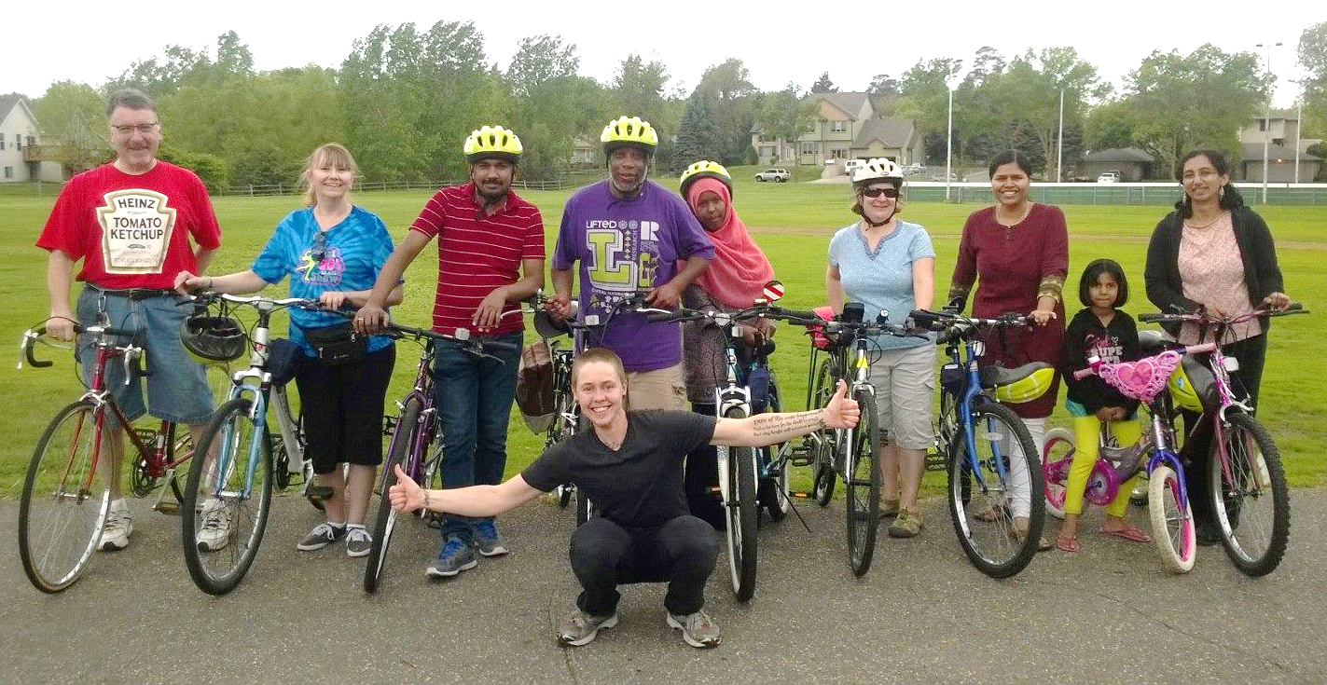
Planning and health
A community’s comprehensive plan can be a powerful tool to shape growth and development
    And address many
    of the social determinants of health

Slide 13

Planning and health
Planning can also play a role in
reducing health disparities,
    which are differences in health that stem
    from the built and social environment.
And increasing health equity,
    which results when everyone can achieve their full health potential, and avoidable differences in health are eliminated
Improving wellness and quality of life for all residents.

Slide 14

Health in planning
How can local governments more
equitably address people’s basic needs
through policy, systems, the built
environment, and public education?
  Food
  Water
  Air
  Shelter
  Safety, security, and well-being
  Social networks
  Jobs
  Education
Notes:
Using data to show where your community is now in these areas help s to tell a compelling story. One of the areas that tends to get ignored is using health data in the plan. APA research shows that even the cities who do best in addressing health in planning, do not utilize data all that effectively.
At Hennepin county, we are having difficulty with this ourselves – finding the right data and linking built environment and health data.
We don’t have info or a data base set up, but can work with communities on an individual basis if they need help locating health data.
Safety, security and wellbeing includes: personal safety, financial security, health and well-being, safety nets against accidents and illness
Maslow’s Hierarchy of Needs: If the bottom 4, most fundamental needs are not met there will be anxiousness and a person will be tense. It may play out in other physiological ways. This theory suggests that the most basic level of needs must be met before the individual will strongly desire or focus motivation upon the secondary or higher needs.

Slide 15


Where does health fit in?
Health
Health
Health
Economic Dev
Land Use
Is it a separate topic or chapter?
Is it integrated in all chapters?
Both?
Health
Health
Transportation
Public Safety
Health
Health
Notes:
Question – Does health have to be a specifically defined “branch” or plan chapter? Or should health-supporting policies be embedded throughout the document?
Research by the American planning Association shows that the most effective plans (for health) do both.

Slide 16

Osseo: a local draft plan update example
Draft Osseo plan is already complete!
Planning & health section + health woven throughout
Focuses on health as wellbeing - WHO definition of health
Discusses the determinants of health

Slide 17
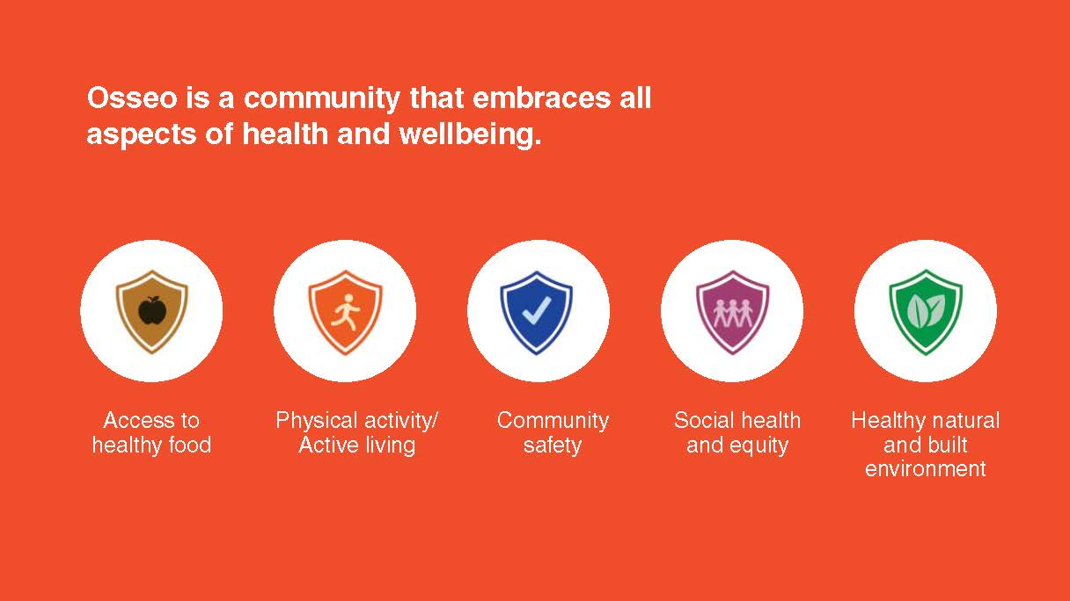
Osseo: a local draft plan update example
Five health themes identified:
Five health themes identified

Slide 18
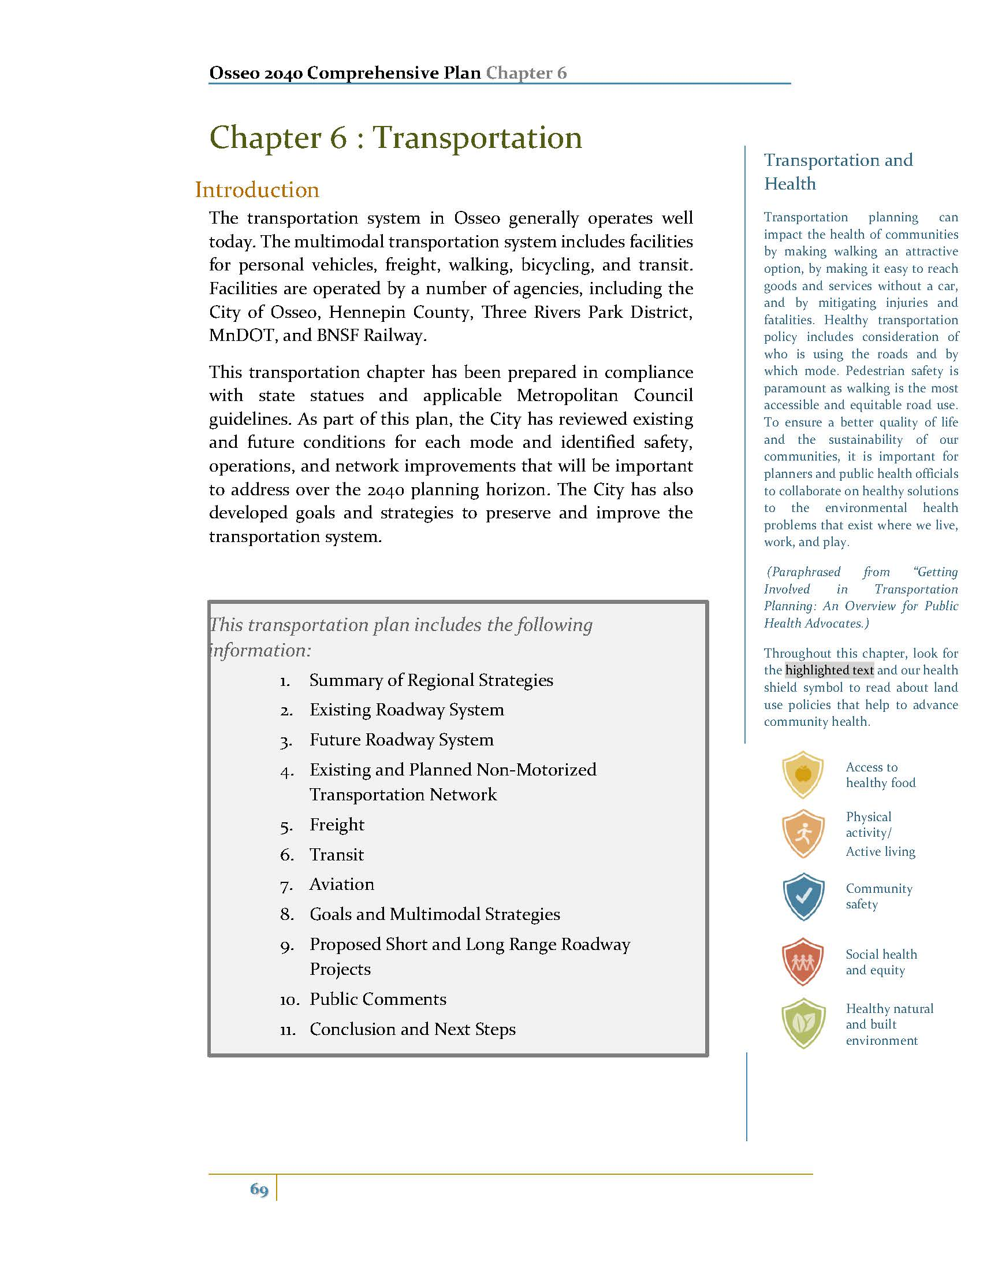
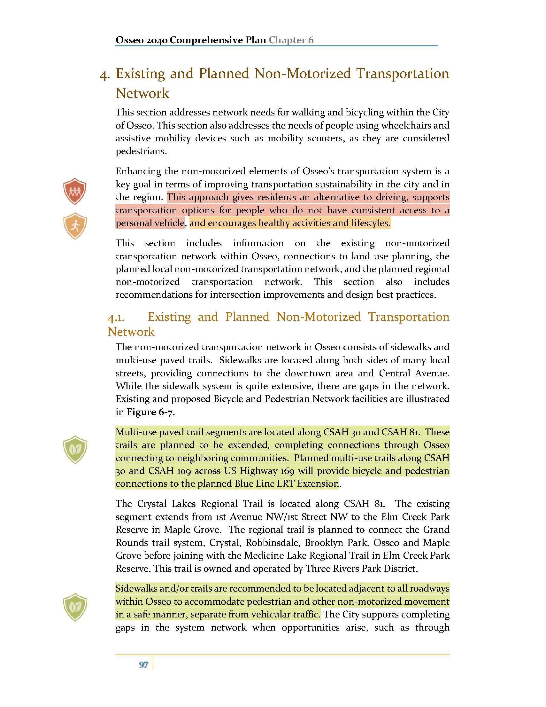
Osseo: a local draft plan update example
Plan Chapters:
Articulate relationship to health
Call out
health-related strategies by theme
www.discoverosseo.com/comp-plan

Slide 19
Healthy comprehensive plans checklist

Slide 20
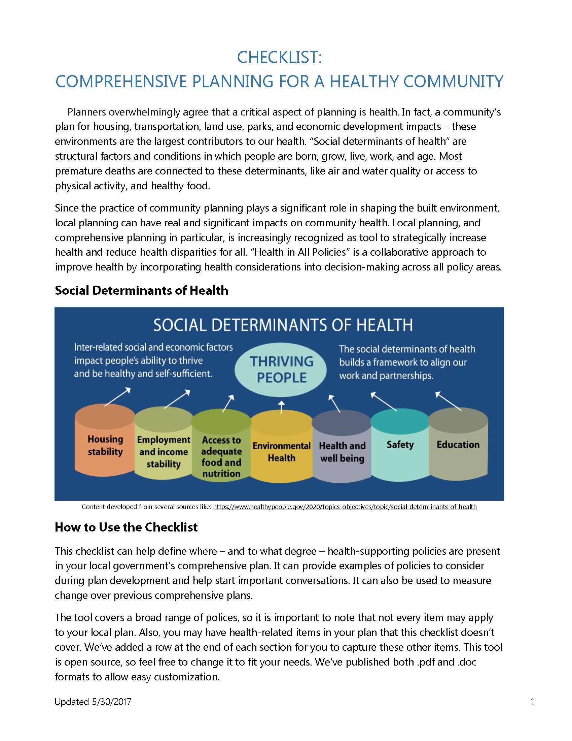
Healthy Comprehensive Planning Checklist
Developed by the Healthy Comprehensive Plans workgroup
    Resource group for city & county planners and health staff
Checklist objectives:
    Tool for staff and others working directly on plans
    Address the SDOH and MN Statewide Health Improvement Partnership (SHIP) strategies
    Include content for all plan elements
    Important to include or address community engagement, equity, and health data
Notes:
Began convening in May, 2016
Resource for city and county planners and health staff who are working on
their jurisdiction’s comprehensive plan
Working from the broadest possible definition of health,
focus on how to include health and equity considerations in these plans
Workgroup identified priorities:
Support and learning
Create tools, share best practices and get technical assistance
Networking and connections
Workgroup identified desire for a tool or checklist
Tie health into comp plans broadly – not segregated into one health chapter
Based on several existing checklist models
Designed with the 7-County Twin Cities Metro area in mind
Many portions may be more broadly applicable
Prepared by taskforce from the workgroup
MDH, Dakota Co., Hennepin Co., BCBS/Terra Soma, City of Shakopee
Tested by professionals /colleagues across the metro
Different size cities, counties, etc.

Slide 21



Healthy Comprehensive Planning Checklist
Based on several existing checklist models
Designed with the 7-County Twin Cities Metro area in mind
    Many portions may be more broadly applicable
Prepared by taskforce from the workgroup
    MDH, Dakota Co., Hennepin Co., BCBS/Terra Soma, City of Shakopee
Tested by professionals /colleagues across the metro
    Different size cities, counties, etc.

Slide 22
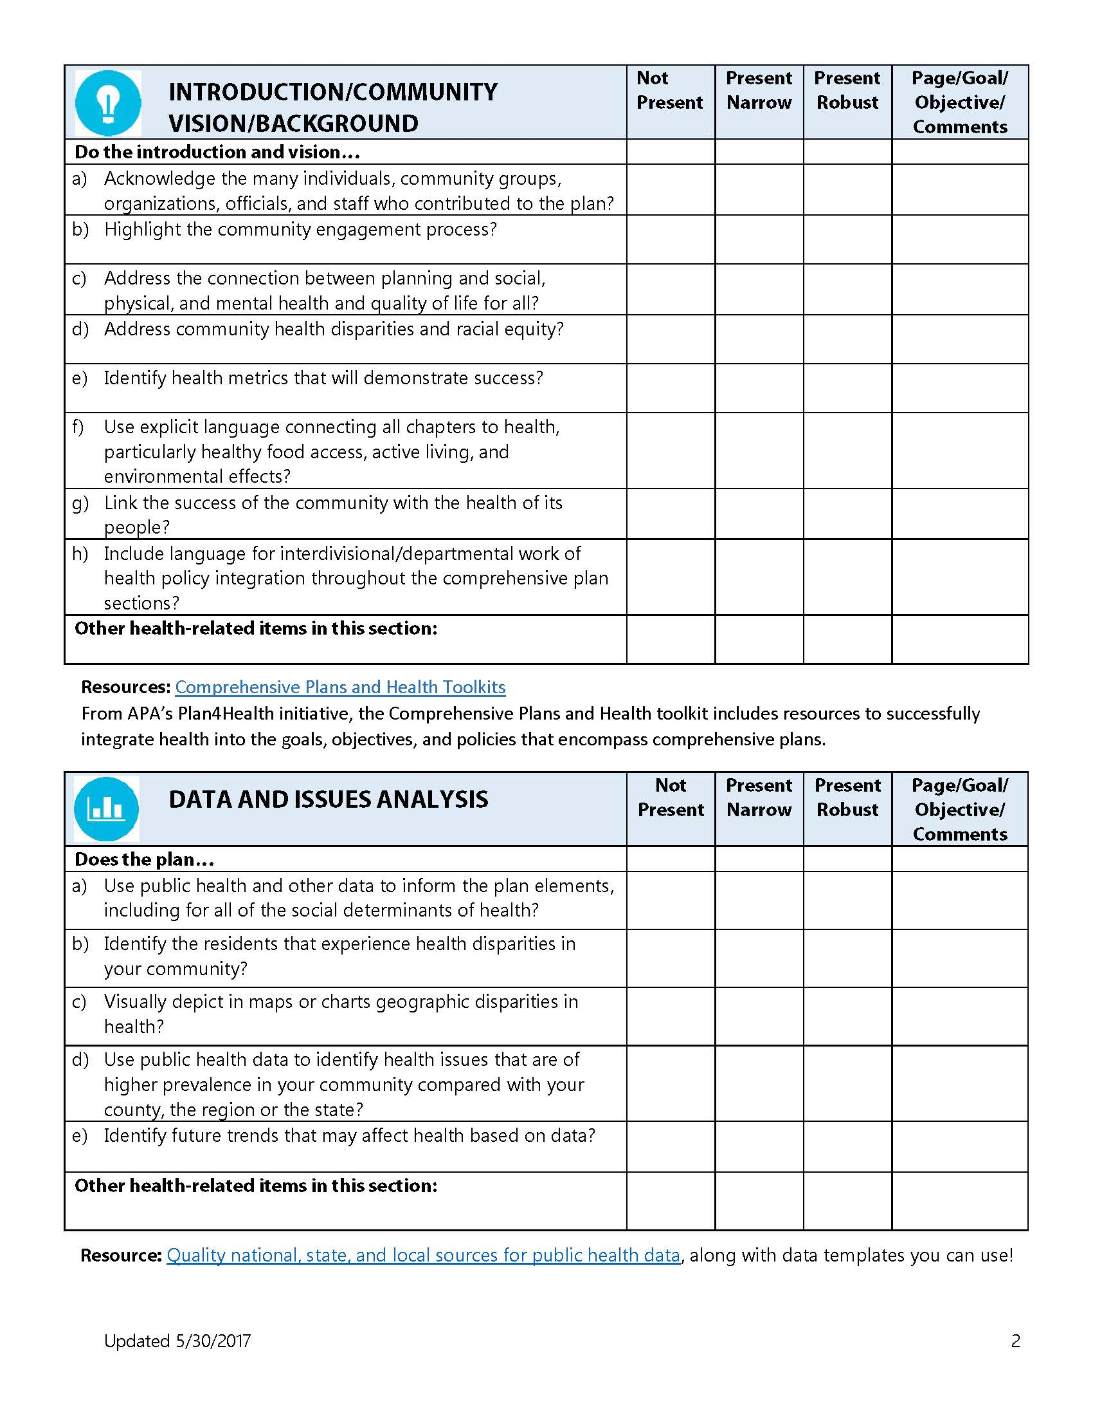
Healthy Comprehensive Planning Checklist
Designed for easy review of existing plans and
draft plan language
    Helps define where, and to what degree,
    health-supporting policies are present
Helps evaluate progress on current plans
Provides examples of policies to consider
during plan development
Can also be used to start conversations
or make recommendations
See http://www.hennepin.us/activeliving, under Metro Healthy Comprehensive Plans Workgroup - Resources
Notes:
Helps define where, and to what degree, health-supporting policies are present
Can provide examples of policies to consider during plan development

Slide 23
Denise Engen
denise.engen@hennepin.us, 612-348-4454

