Slide 1
June 23, 2017
Energy And the Comprehensive Plan
Brian Ross, AICP, LEED GA
Senior Program Director
Abby Finis
Senior Planner

Slide 2
Minnesota’s Local Government Project for Energy Planning (LoGoPEP) builds upon existing efforts to engage local governments in committing to actionable strategies for energy and greenhouse gas emission reductions.
LoGoPEP will provide communities with planning tools and actual results to measure progress toward their goals. This project is being developed at the Twin Cities metropolitan regional scale with the goal of future replicability and institutionalization throughout the state.

Slide 3
Energy planning tools and resources include:
Case studies of energy strategies implemented by exemplar cities;
A wedge diagram tool for energy and greenhouse gas reduction planning with an associated menu of feasible city actions;
An energy planning guide and workbook for use in the 2040 comprehensive planning process
A solar energy calculator to help communities understand their available solar energy resources and set solar electricity goals;
A guide on how to incorporate energy and/or climate resilience in a city's request for proposal.

Slide 11
Technical Assistance to GreenStep Cities
The GreenStep Cities program is providing technical assistance to Metro cities to address energy and climate in their comprehensive plans and implementation efforts.
All GreenStep Cities at Step 2 or higher will have Regional Indicator Initiative data compiled or updated (Statewide).
The LoGoPEP program is entering a new phase outside the Metro area. Technical assistance is available for ten cities to incorporate energy and climate benchmarking and goals into Comprehensive Plans or other policy documents (based on Regional Indicators data).

Slide 12
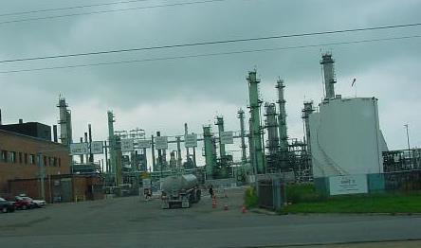
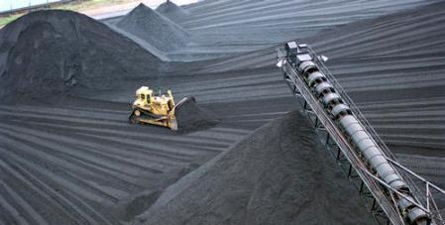
What are Energy “Reserves”?
Proved oil and gas reserves - those quantities of oil and gas, which, by analysis of geoscience and engineering data, can be estimated with reasonable certainty to be economically producible–from a given date forward, from known reservoirs, and under existing economic conditions, operating methods, and government regulations.
(SEC definition of proved reserves)

Slide 13
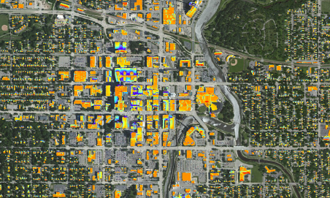
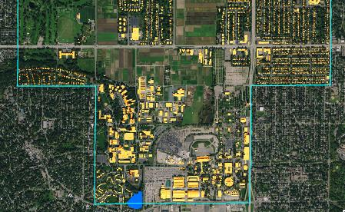
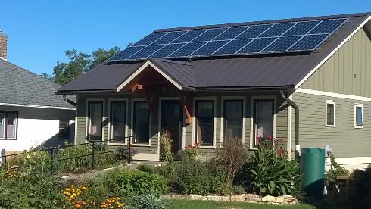
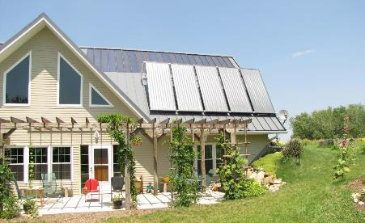
What are Energy “Reserves”?
Proved solar reserves - those quantities of solar energy, which, by analysis of atmospheric and land cover data, can be estimated with reasonable certainty to be economically producible–from a given date forward, from known access to direct sunlight, and under existing economic conditions, operating methods, and government regulations.
(GPI/Grow Solar Partnership definition of proved reserves)

Slide 14
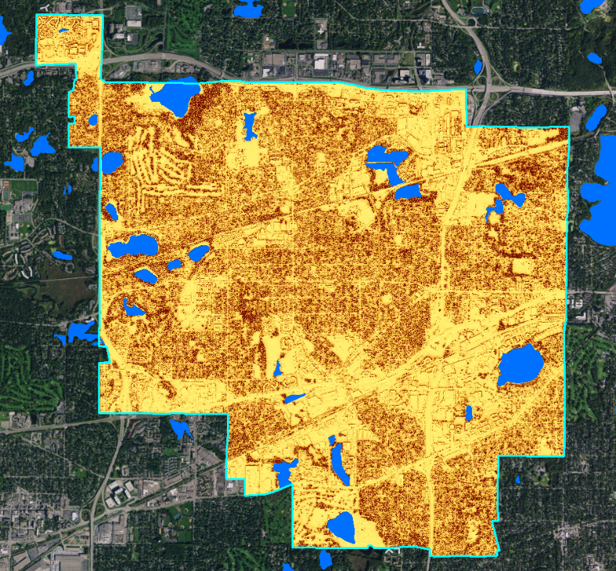
St. Louis Park
Gross reserves
1,217 GWh of electricity,
Approximately 940 MW of generating capacity.
Rooftop reserves
216 GWh of electricity (43% of electric use)
approximately 170 MW of generating capacity.
Annual electricity consumed – 498 GWh (Regional Indicators Initiative)

Slide 15
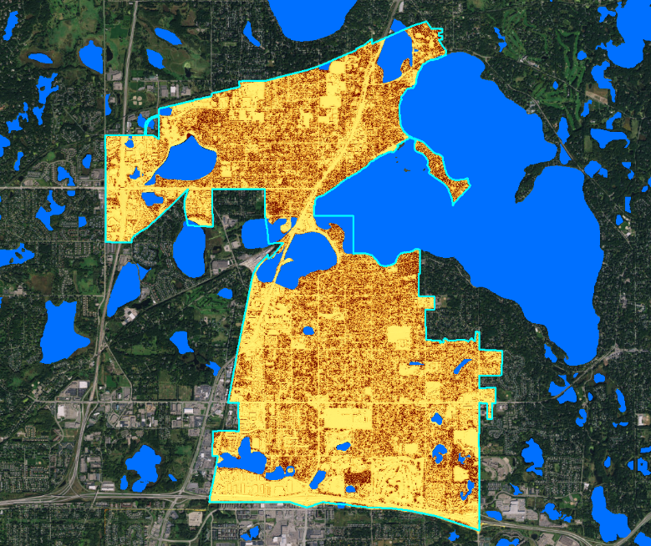
White Bear Lake
Gross reserves
942 GWh of electricity,
Approximately 720 MW of generating capacity.
Rooftop reserves
120 GWh of electricity (62% of electric use)
approximately 90 MW of generating capacity.
Annual electricity consumed – 194 GWh (Regional Indicators Initiative)

Slide 16
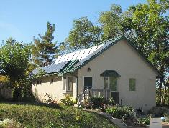
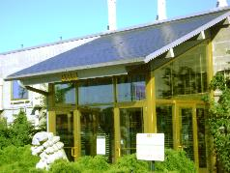
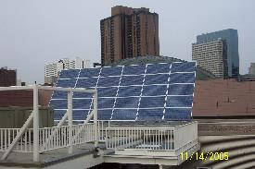
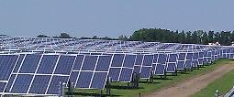
Required in Minnesota Statutes
Metropolitan Land Planning Act
Subd. 2. Land use plan. (b) A land use plan shall contain a protection element, as appropriate, for historic sites, the matters listed in the water management plan required by section 103B.235, and an element for protection and development of access to direct sunlight for solar energy systems.

Slide 17
Metro Communities Solar Planning Requirement
What must a community include in the 2040 Comprehensive Plan Update to meet statutory planning requirements for the protection and development of solar resources?
Existing Conditions – Solar Resource Protection
It is expected that communities will include gross solar and rooftop solar potential estimates, along with a community solar map within the Comprehensive Plan Update in order to satisfy the resource protection requirement.
Desired Conditions – Solar Resource Development
In order to satisfy the resource development requirement, communities will need to include a policy and implementation strategy for the development of solar resources (direct access to sunlight for solar energy systems).
Notes:
(ERIC)
To be more specific, the solar calculations and community solar map provided by the Metropolitan Council will need to be included in the Comprehensive Plan to meet the statutory requirement for solar resource protection. To meet the requirement for solar resource development, each community will need to include any policies or strategies that it deems appropriate to ensure that development procedures are in place to ensure direct access to sunlight for solar energy systems. If the elements for solar protection and solar development are not included in the Plan, the Plan will be considered incomplete.

Slide 18
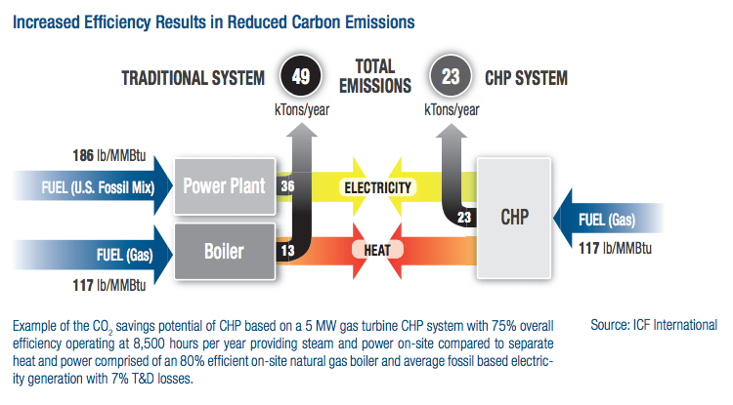
What are local energy resources?
Demand-side energy resources include several distinct resources that are already used extensively by energy utilities:
Energy efficiency – Utilities save energy (efficiency) in existing homes and businesses as a means of meeting new demand.
Demand response – deferring use or dispatching on-site generation to meet
Combined heat and power (CHP) – generation of heat and electricity in the same facility.

Slide 19
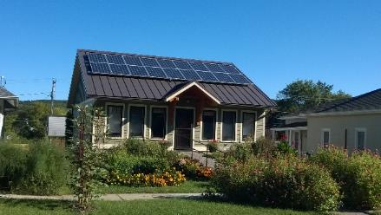
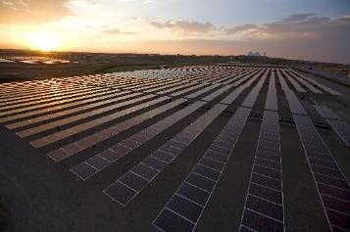
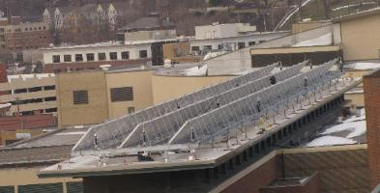
What are local energy resources?
Solar energy resources are the most abundant local energy resource, but also the most distributed. Solar energy is used in several ways:
Accessory electric generation (photovoltaic) in accessory uses behind the electric meter at homes and businesses
Primary electric generation in principal uses and connected to the local distribution grid
Heating applications at both small and large scale

Slide 20
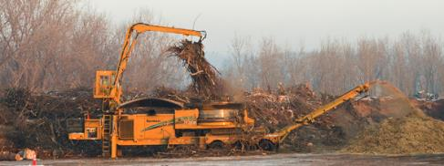
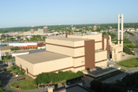
What are local energy resources?
Biomass energy resources include both traditional agricultural production and increasing utilization of non-traditional biomass. Biomass includes:
Corn, soybeans, and crop residues used to produce ethanol for transportation fuels
Wood scrap and residue from logging, urban tree trimming, or construction waste stream for heating or electric generation
Solid waste used for heating or electric generation
Photo credit: Ever-Green Energy
Photo credit: Covanta Energy

Slide 21
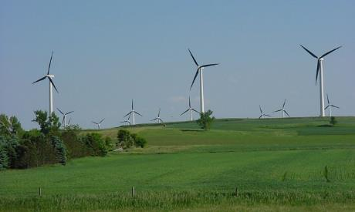
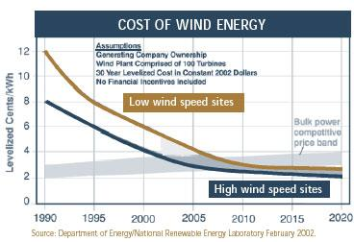
What are local energy resources?
Wind energy resources are Minnesota’s most extensively used and cost effective renewable energy resource. Wind is used to generate electricity as two primary types of land use:
Large “utility-scale” turbines either individually or as a wind farm
Distributed wind serving primarily on-site electric use as an accessory use

